Slide 1
SC cybersecurity
Databricks Enablement Workshop
Day 1 (Workshop 1 & 2)
Hao Wang, hao.wang@databricks.com
Specialist SA, Platform/ML, ASEAN
‹#›

Slide 2




Account Team Member Introduction
Prashant Singh
Solutions Architect
Ayushi Kamboj
Sr. Customer Success Engineer
Hao Wang
Specialist Solutions Architect
Hosting workshop 1, 2
Ankur Khosla
Specialist Solutions Architect
Hosting workshop 3, 4

Slide 3
Day 1 Agenda
Workshop 1 (2 hrs):
1.1 Architecture Foundation (60 min)
Architecture L300 (25 min)
Reference Architectures (15 min)
Exfiltration Protection in Action (10 min)
Splunk - Databricks project architecture (10 min)
1.2 End-to-End ETL examples (60 min)
Demo: Databricks ETL on logs and Splunk integration (30 min)
Orchestration on Azure Databricks (20 min)
Splunk integration use cases open discussion (10 min)

Slide 4
Housekeeping
Voice out to Accelerate when:
Ask questions during workshop
Too simple / Already know it
Needs deeper content (see appendix first)
Expected Outcome of Day 1:
Clear understanding of Databricks Architecture and best practices on Infra & Networking
Know your existing Architecture and how to move towards desired Architecture
Know how to do End to End ETL from logs generation, ingestion to delta, to consumption and Splunk query, and orchestration capabilities
Know basics of Azure DevOps CICD capabilities
Know all log types on Databricks and tools to analyze them
Get concrete use cases in your team on Splunk-Databricks integration and SIEM

Slide 5
Workshop 1
11:00-13:00
Workshop 1 (2 hrs):
1.1 Architecture Foundation (60 min)
Architecture L300 (25 min)
Reference Architectures (15 min)
Exfiltration Protection in Action (10 min)
Splunk - Databricks project architecture (10 min)
1.2 End-to-End ETL examples (60 min)
Demo: Databricks ETL on logs and Splunk integration (30 min)
Orchestration on Azure Databricks (20 min)
Splunk integration use cases open discussion (10 min)
Notes:
Tag:azure,aws,gcp

Slide 6
Architecture L300 (25 min)
Notes:
Tag:azure,aws,gcp

Slide 7

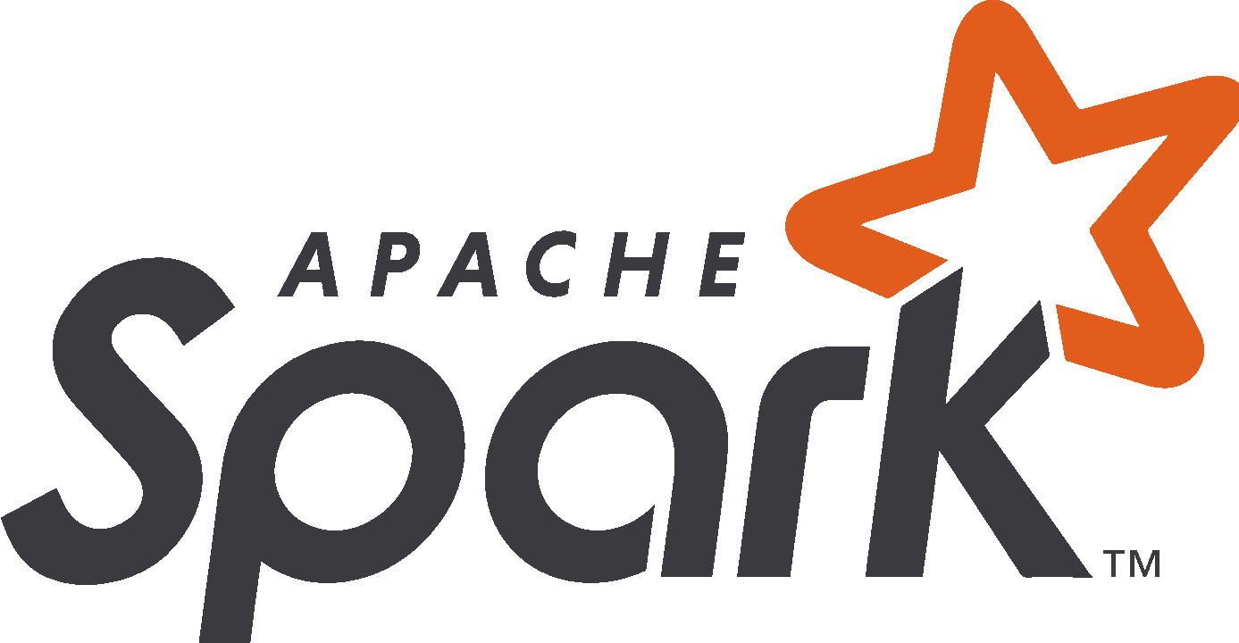

1.1 Architecture Foundation
Without Unity Catalog
Customer
Databricks Control Plane
Databricks Data Plane
Hive Metastore
Cluster Manager
Clusters
*
driver
driver
worker
...
worker
Web App
Jobs Scheduler
worker
worker
*
Cluster 1
Cluster n
Azure Databricks is a first party Azure service
Azure Blob Storage / ADLS
DBFS
System
*
Cluster Manager in Control Plane manages clusters
One bucket, holding public and private (system) DBFS
No costs when all Databricks clusters are down
Azure Portal
Azure Databricks architecture overview
* Deployment triggered

Slide 8
1.1 Architecture Foundation
With Unity Catalog
Customer
Unity Catalog
Databricks Control Plane
Databricks Data Plane
(Unity)
Metastore
Hive Metastore
Cluster Manager
Clusters
*
driver
driver
worker
...
worker
User Management
Web App
Jobs Scheduler
worker
worker
*
Cluster 1
Cluster n
Discovery & Lineage
Azure Databricks is a first party Azure service
Databricks Account Console
Azure Blob Storage / ADLS
DBFS
System
*
Cluster Manager in Control Plane manages clusters
One bucket, holding public and private (system) DBFS
No costs when all Databricks clusters are down
Azure Portal
Azure Databricks architecture overview
* Deployment triggered

Slide 9
Azure Databricks Network Architecture
Bring Your Own Vnet (VNet Injection)
Secure Cluster Connectivity
Cluster Deployment
Customer VNet
Azure Back
bone
VNet
Azure Back
bone
NAT GW
Virtual Machine
container subnet
host subnet
container subnet
host subnet
Container
NSG*
NSG*
NSG
NSG
SCC Relay
Virtual Machine
Container
Cluster internal communication
Communication with other services
Virtual Machine
Control Plane
Virtual Machine
Control Plane
Container
Container
Virtual Machine
Container
Vnet Injection : Deploy Azure Databricks workspace in your own Virtual Network (VNet). One of the important features is full access to the NSGs.
Secure Cluster Connectivity (SCC): Network Traffic between the cluster and Control Plane goes outbound from the cluster to the Control Plane.
Best practice is to use both, VNet Injection and SCC
container subnet *
host subnet *
* Managed by the customer
** “container subnet” is also referred to as “private subnet” and “host subnet” as “public subnet”. Since the terms “private” and “public” are misleading, “container” and “host” are preferred
Notes:
tag:azure

Slide 10
IP address ranges of Azure Databricks
Necessary IP ranges (subnets) for VNet injection
VNet /16 - /24 (e.g. /20)
Host (”public-subnet”) up to /26 (e.g. /21)
Container (”private-subnet”) up to /26 (e.g. /21)
Public IP (for non-NPIP) Azure space
Notes:
Private CIDR range size = Public CIDR range size
Azure reserves 5 addresses for internal purposes (i.e. a /20 VNet with /21 subnets would allow for 2043 nodes)
Even for “No Public IP” workspaces the host network is called “public-subnet” in the Azure Portal, however, it is a private IP range
H
C
Other VNets
Customer managed Databricks Workspace VNet
1 IP * per VM
VM 1 (driver)
VM 2 (worker)
…
VM n (worker)
Routing*
Container
H
Container
H
Container
H
DBR
C
DBR
C
DBR
C
1 private IP per container
* Several options are supported, e.g
Vnet Peering
User Defined Routes (UDR)
VM and container based Databricks cluster on Azure
* Private IP for SCC workspaces else public IP
Notes:
tag:azure

Slide 11
Communication in a Databricks Workspace
Customer on premises
Databricks Control Plane
(Microsoft VNet)
Web App
Browser
@
@
User
BI Tools
Metastore
REST Client
Log / Tele- metry (TM)
Artefact Store
@
Notes:
Data Plane and Control Plane always communicate over Azure Backbone
Control Plane to DBFS is going over Azure Backbone since both are first party Azure services
Nevertheless, communication between Control and Data Plane uses Public IPs on both planes
Users access Databricks over the Public Internet
@
@
Data Plane (Customer VNet)
Root container (DBFS)
host subnet
Databricks Clusters
= via Azure Backbone
= Public IP
@
Notes:
tag:azure

Slide 12
Communication in an SCC workspace
Customer on premises
Databricks Control Plane
(Microsoft VNet)
Web App
Browser
@
@
User
BI Tools
Metastore
SCC Relay
REST Client
Log / Tele- metry (TM)
Artefact Store
@
Notes:
The workspace needs to be deployed in customer’s VNet (VNet injection)
Secure Cluster Connectivity reverses the call direction via the SCC Relay and removes Public IPs from the Data Plane. Calls from Data Plane to the Control Plane still use Public IPs
The goal of Private Link is to remove Public IPs from the Control Plane, see next slides
Data Plane (Customer VNet)
@
host subnet
Root container (DBFS)
Databricks Clusters
= via Azure Backbone
= Public IP
@
Notes:
tag:azure

Slide 13


Data Exfiltration Protection
Customer on premises
Databricks Control Plane
(Microsoft VNet)
Firewall rules
 | Name | Purpose
1 | databricks-webapp | Communication with Azure Databricks webapp
2 | databricks-log-blob-storage | Store Azure Databricks audit and cluster logs (anonymized / masked) for support and troubleshooting
3 | databricks-artifact-blob-storage | Databricks Runtime images to be deployed on cluster nodes
4 | databricks-dbfs | Azure Databricks workspace root storage
5 | databricks-sql-metastore | Stores metadata for databases and child objects
... | ... | Business specific rules (artifactory, monitoring, …)
Web App
Browser
@
1
User
BI Tools
Metastore
SCC Relay
5
@
@
REST Client
3
@
Log / Tele- metry (TM)
Artefact Store
2
@
Notes:
All traffic is routed according to User Defined Routes (UDR)
It is not recommended to route the SCC connection through Azure Firewall (avoid the additional hop)
Optionally, one can set up an external Metastore, e.g. Azure SQL (also behind a Private Link)
This architecture can be combined with Private Link
Hub (Customer
Hub VNet)
4
Data Plane (Customer VNet)
@
host subnet
Root container (DBFS)
Azure
Firewall
Databricks Clusters
PE subnet
Storage PE
UDR
VNet Peering
SCC
0.0.0.0/0
PE = Private Endpoint
= via Azure Backbone
= Public IP
ADLS
@
Notes:
tag:azure

Slide 14
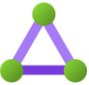

Private Link (1/3) - User to Workspace
Public Preview
Customer on premises
Bastion / Hub (Hub VNet)
Databricks Control Plane (Microsoft VNet)
DNS
Use Case:
Connectivity from User to Workspace endpoints (including notebooks, REST API, JDBC/ODBC, Databricks Connect)
Express Route / VPN
Express Route / VPN Gateway
PE for Web App
Private Link Service
Web App
Browser
@
User
BI Tools
Metastore
SCC Relay
REST Client
Log / Tele- metry (TM)
Artefact Store
@
Notes:
The Bastion/Hub VNet is different from the Data Plane VNet
At workspace creation time, “Allow Public Network Access” needs to be set to “Disabled” to remove public IPs. However, to access CP from 3rd party cloud services that cannot go through the bastion, Public IPs of the CP need to be enabled, but should be secured using the IP Access list feature
For SSO a private endpoint to AAD is necessary, however an existing one can be used
Relevant DNS changes needed to route traffic to the private endpoint for the Web App
The same setup would work when the customer works from a cloud VM instead of on premises
Data Plane (Customer VNet)
@
host subnet
Root container (DBFS)
Databricks Clusters
PE = Private Endpoint
= via Azure Backbone
= Public IP
@
Notes:
tag:azure

Slide 15
Private Link (2/3) - DP to CP & DBFS
Public Preview
OPTION 1
(As a subnet for one Databricks VNet)
Customer on premises
Bastion / Hub (Hub VNet)
Databricks Control Plane (Microsoft VNet)
DNS
Use Case:
Connectivity from Databricks Data Plane (in customer-managed VNet) to Control Plane and DBFS
Express Route / VPN
Express Route / VPN Gateway
PE for SCC Relay & Web App
Private Link Service
Web App
Browser
User
BI Tools
SCC Relay
REST Client
Log / Tele- metry (TM)
Artefact Store
@
Notes:
Can be combined with the “User to Workspace” setup
At workspace creation time, “Required NSG Rules” need to be “No Azure Databricks rules”
The workspaces should also connect via Private Endpoints to customer’s storage like ADLS, databases, …
An external Metastore can be connected via Private Link
On Azure, Log / Telemetry and Artefact Store currently cannot be put behind a PE (technical limitations)
Data Plane (Customer
VNet)
Root container (DBFS)
PE for SCC Relay & Web App
PE subnet
host subnet
PE for Storage
Databricks Clusters
PE for Metastore
PE = Private Endpoint
= via Azure Backbone
= Public IP
external Metastore
@
Notes:
tag:azure

Slide 16
Private Link (3/3) - DP to CP & DBFS
Public Preview
OPTION 2 (In the hub to support multiple Databricks VNets)
Customer on premises
Bastion / Hub (Hub VNet)
Databricks Control Plane (Microsoft Vnet)
DNS
Use Case:
Connectivity from Databricks Data Plane (in customer-managed VNet) to Control Plane and DBFS
Express Route / VPN
Express Route / VPN Gateway
PE for Web App & SCC Relay
Private Link Service
Web App
Browser
User
BI Tools
SCC Relay
REST Client
Log / Tele- metry (TM)
Artefact Store
PE for Metastore
PE for Storage
@
Notes:
see last slide
Data Plane (Customer VNet)
Root container (DBFS)
host subnet
VNet Peering
Databricks Clusters
PE = Private Endpoint
= via Azure Backbone
= Public IP
external Metastore
@
Notes:
tag:azure

Slide 17
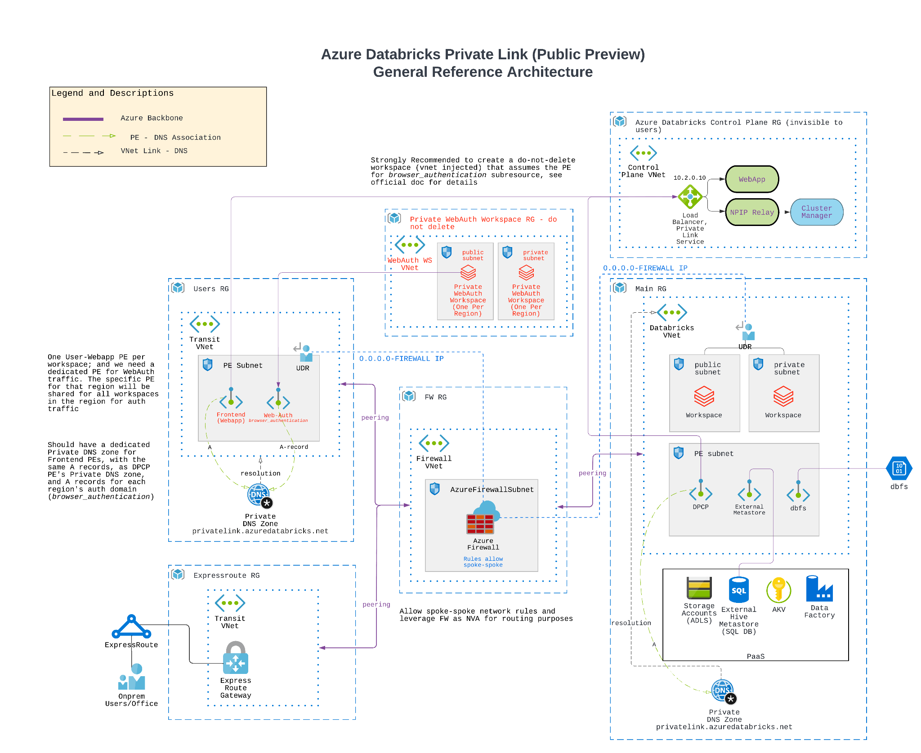
Notes:
tag:azure

Slide 18
Reference Architectures (15 min)
Notes:
Tag:azure,aws,gcp

Slide 19



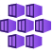
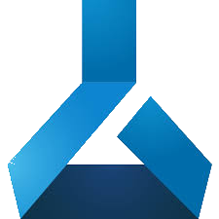

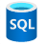

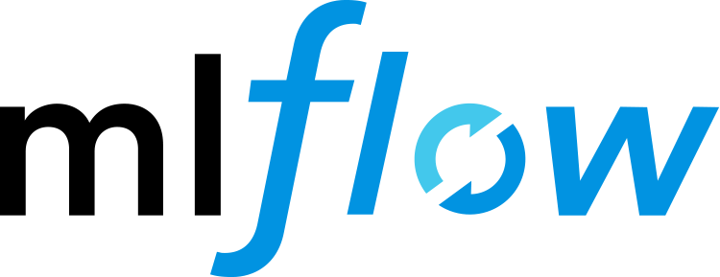


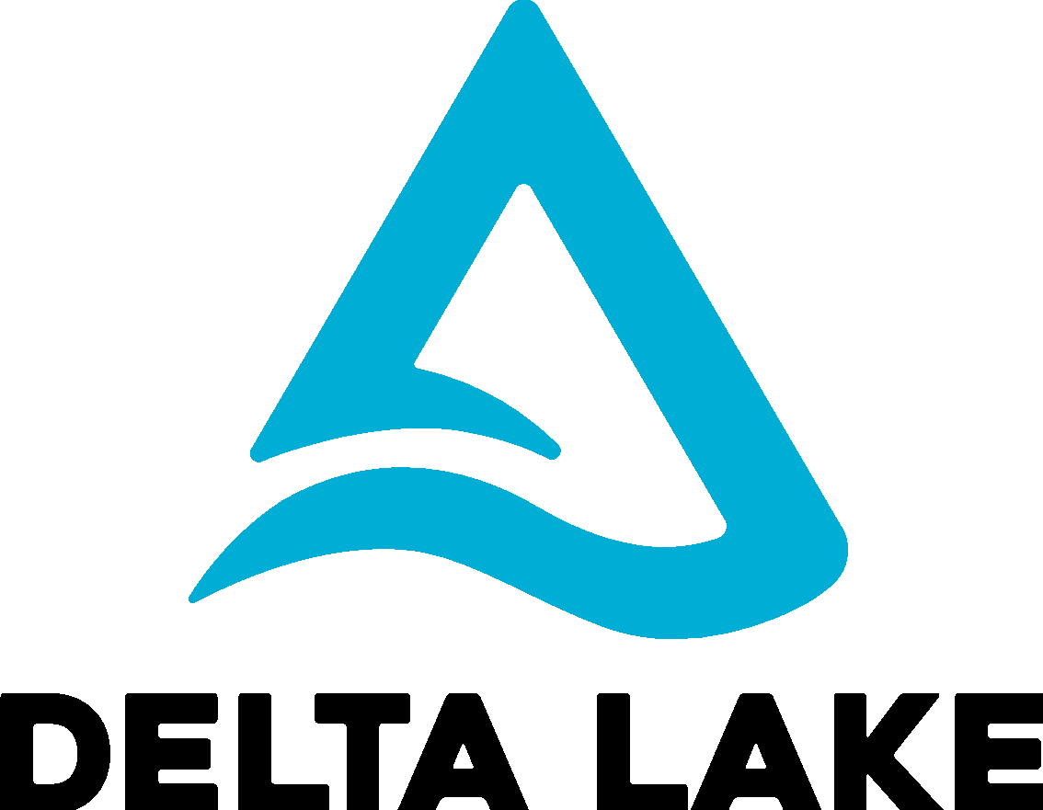
Databricks Lakehouse Overview
Governance
Unity Catalog
Ingest
Store
Process
Serve
Model Serving
Sensors and IoT
(unstructured)
Azure IoT Hub
Spark Structured Streaming
Model
Serving
Azure Machine Learning
Azure Kubernetes Service
CDC
Event Hub Capture + Databricks AutoLoader
RDBMS (structured)
Azure Event Hub
Operational Databases
Apps
Media (unstructured)
SQL DB
Cosmos DB
Databricks SQL
Files / Logs (unstructured)
Azure Databricks
Power BI
Business Apps
(structured)
Azure Data Factory
Azure Data Lake Storage
Other clouds
bronze
silver
gold
Notes:
tag:azure
Notes:
Databricks Model Serving V1 is single node (a job cluster) without HA and scaling capabilities and Databricks Model Serving V2 is in Private Preview. If this is a show stopper for a customer, Azure ML and AKS are the way to go
The easiest path to PowerBI (no additional export to another system) is querying directly to DB SQL

Slide 20
1 Batch ETL
Governance
Unity Catalog
Ingest
Store
Process
Serve
Sensors and IoT
(unstructured)
RDBMS (structured)
Media (unstructured)
Databricks SQL
Files / Logs (unstructured)
Azure Databricks
e.g. AutoLoader
Business Apps
(structured)
Azure Data Factory
Azure Data Lake Storage
Other clouds
bronze
silver
gold
Notes:
tag:azure

Slide 21
2 Streaming
Governance
Unity Catalog
Ingest
Store
Process
Serve
Sensors and IoT
(unstructured)
Azure IoT Hub
Spark Structured Streaming
Event Hub Capture
RDBMS (structured)
Azure Event Hub
Operational Databases
Media (unstructured)
SQL DB
Cosmos DB
Databricks SQL
Files / Logs (unstructured)
Azure Databricks
Business Apps
(structured)
Azure Data Lake Storage
Other clouds
bronze
silver
gold
Notes:
tag:azure

Slide 22
3 CDC
Governance
Unity Catalog
Ingest
Store
Process
Serve
Sensors and IoT
(unstructured)
Azure IoT Hub
Spark Structured Streaming
CDC
Event Hub Capture
RDBMS (structured)
Azure Event Hub
Operational Databases
Media (unstructured)
SQL DB
Cosmos DB
Databricks SQL
Files / Logs (unstructured)
Azure Databricks
Business Apps
(structured)
Azure Data Factory
Azure Data Lake Storage
Other clouds
bronze
silver
gold
Notes:
tag:azure

Slide 23
4 Data Science and ML
Governance
Unity Catalog
Ingest
Store
Process
Serve
Model Serving
Sensors and IoT
(unstructured)
Model
Serving
Azure Machine Learning
Azure Kubernetes Service
RDBMS (structured)
Operational Databases
Apps
Media (unstructured)
SQL DB
Cosmos DB
Databricks SQL
Files / Logs (unstructured)
Azure Databricks
Business Apps
(structured)
Azure Data Lake Storage
Other clouds
bronze
silver
gold
Notes:
tag:azure
Notes:
Databricks Model Serving V1 is single node (a job cluster) without HA and scaling capabilities and Databricks Model Serving V2 is in Private Preview. If this is a show stopper for a customer, Azure ML and AKS are the way to go

Slide 24
5 BI/SQL Analyst
Governance
Unity Catalog
Ingest
Store
Process
Serve
Sensors and IoT
(unstructured)
RDBMS (structured)
Media (unstructured)
Databricks SQL
Files / Logs (unstructured)
Azure Databricks
Power BI
Business Apps
(structured)
Azure Data Lake Storage
Other clouds
bronze
silver
gold
Notes:
tag:azure
Notes:
The easiest path to PowerBI (no additional export to another system) is querying directly to DB SQL

Slide 25
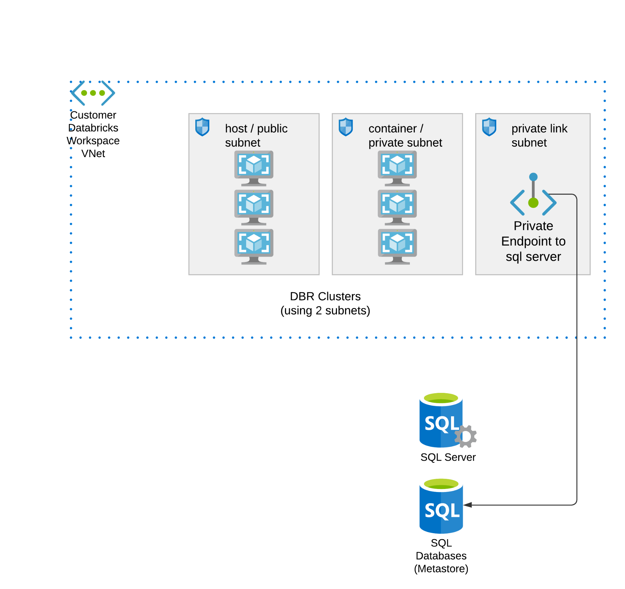
Demo in Azure 10 min
External Hive Metastore for Databricks workspaces
High Level Architecture of External Hive Metastore
When to use External Hive Metastore:
You need to store Table Metadata in your accounts.
You need to share metadata across workspaces. (configure clusters in workspaces A and B to point to the same external hive metastore for sharing)
Common Troubleshooting Tips:
Test the networking connectivity from Databricks clusters to your sql db.
Check if your sql db have been properly initialized (you should see all the schemas created)
Checkout the readme walkthrough: https://github.com/hwang-db/tf_azure_deployment/tree/master/adb-external-hive-metastore

Slide 26
Demo: Exfiltration Protection in Action
(10 min)
Notes:
Tag:azure,aws,gcp

Slide 27
Data Exfiltration Protection Azure Databricks
Key takeaway: Exfiltration Protection is all about controlling egress destination
Wikipedia definition: Data exfiltration occurs when malware and/or a malicious actor carries out an unauthorized data transfer from a computer. It is also commonly called data extrusion or data exportation.
Exfiltration Protection is not about protecting your storage account from infiltration
Exfiltration Protection is about data EGRESS control - where can data go out from the network to?
Read: How to protect Data Exfiltration with Azure Databricks to help ensure Cloud Security

Slide 28
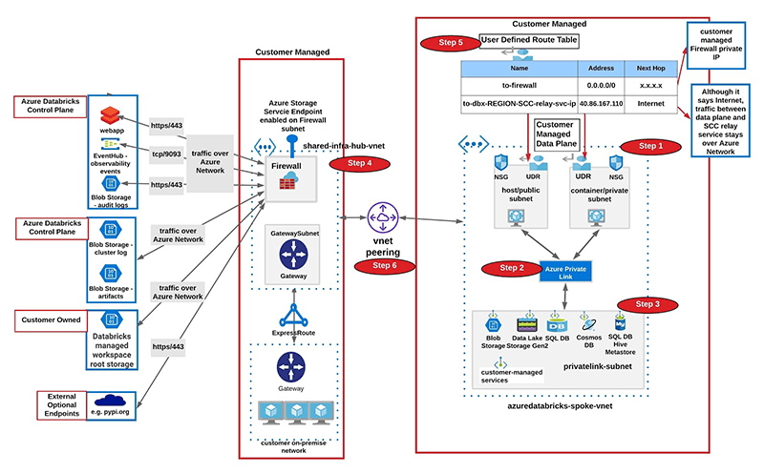
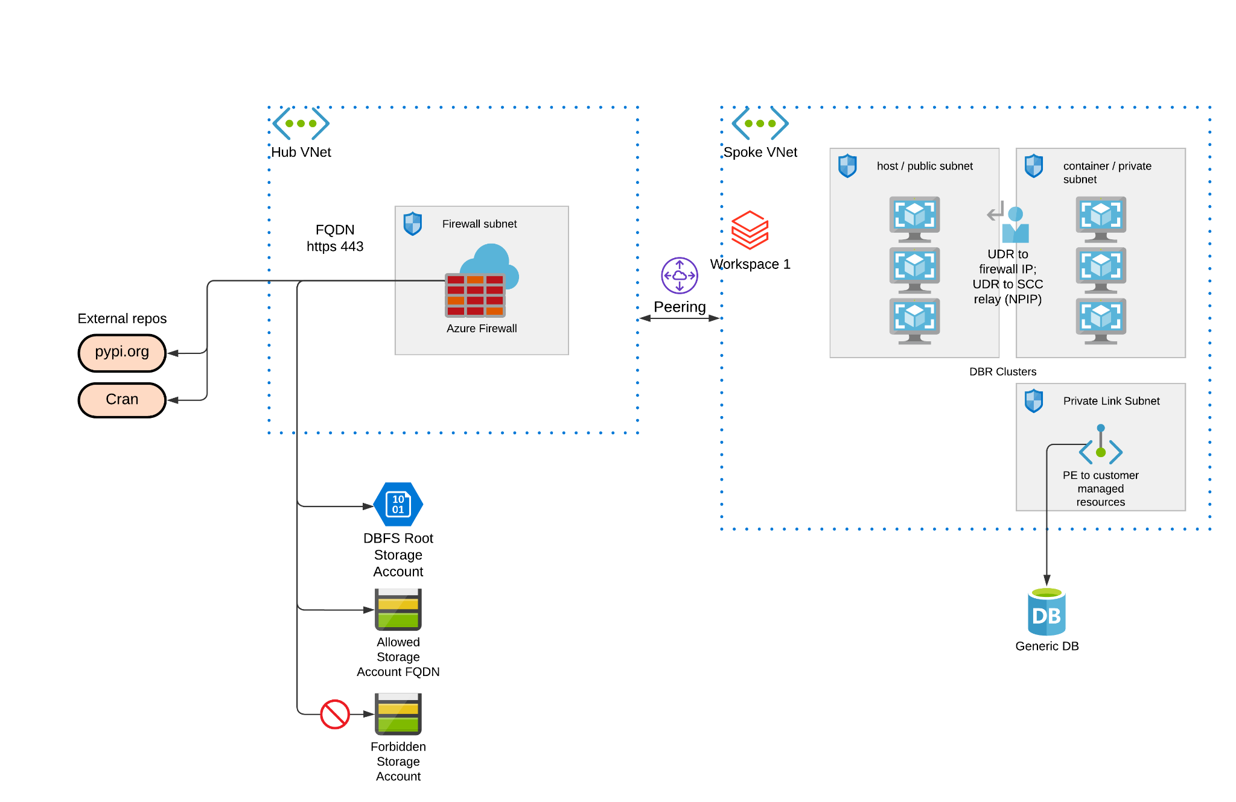
Demo in Azure 10 min
Data Exfiltration Protection Azure Databricks
High Level Architecture of Exfiltration Protection Methods
How to protect Data Exfiltration with Azure Databricks to help ensure Cloud Security
Reference terraform example: https://github.com/hwang-db/tf_azure_deployment/tree/master/adb-exfiltration-protection

Slide 29
Splunk - Databricks Project Architecture (10 min)
Notes:
Tag:azure,aws,gcp

Slide 30
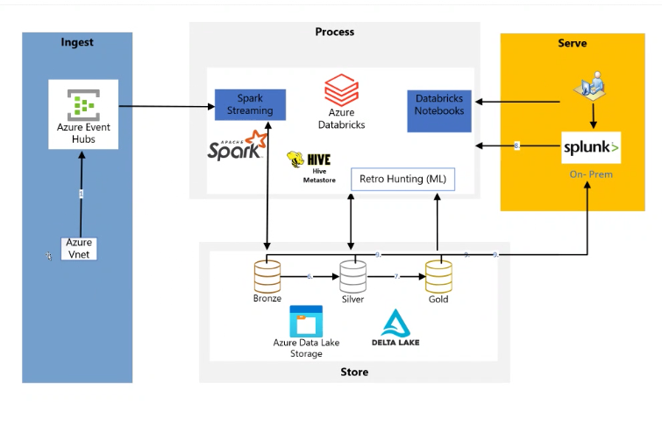
1.1 High Level Design Architecture
High Level Architecture Diagram in Cybersecurity Splunk project
Foundation Design Decisions:
SCC NPIP workspace, VNet injection
Private Links (frontend, backend)
Private Link connections to PaaS
Where to add more details into diagram:
SC networking barebone structure
Connections between your services and onprem

Slide 31
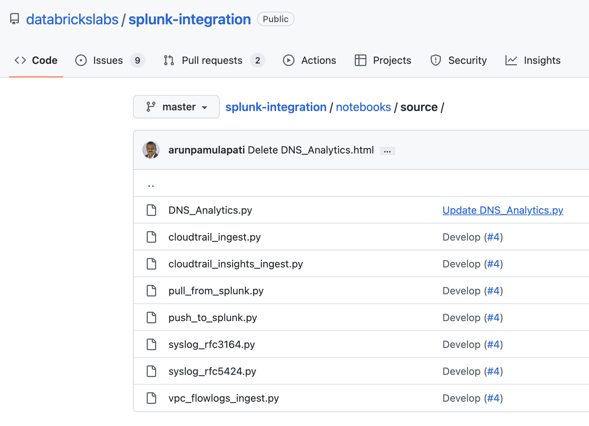
1.1 High Level Design Architecture
Use cases for Splunk-Databricks Add-on
What you can do with this integration:
From Splunk, query Databricks Tables and get results back
From Databricks, Push / Pull to/from Splunk via splunk’s API
Do Log analysis on Databricks, create silver gold layers and push final layer to splunk
See in demo environment on detailed capabilities list
https://github.com/databrickslabs/splunk-integration/tree/master/notebooks/source

Slide 32
Demo:
Databricks ETL on logs and Splunk integration
(30 min)
Stage 1
PaaS / IaaS (windows VM, linux VM) generating logs
Stage 2
Generated logs land into Blob / ADLS / Eventhubs
Stage 3
Databricks Autoloader ingest log files into Bronze Delta Table (put delta tables in ADLS)
Stage 4
Continue building ETL pipelines, Silver, Gold tables
Optimization and create your jobs in production
Stage 5
Splunk-Databricks Integration, build your use cases:
Splunk query data from Databricks Delta Tables
Stage 6
Chain all stages together and automate the pipelines

Slide 33
1.2 ETL on logs using Databricks - Demo
To show log generation and landing
Stage 1
PaaS / IaaS (windows VM, linux VM) generating logs
Stage 2
Generate logs lands into Blob / ADLS / Eventhubs
Stage 3
Databricks Autoloader ingest log files into Bronze Delta Table (put delta tables in ADLS)
Stage 4
Continue building ETL pipelines, Silver, Gold tables
Optimization and create your jobs in production
Stage 5
Splunk-Databricks Integration, build your use cases:
Databricks push to splunk
Databricks pull from splunk
Splunk query data out from Databricks Delta Tables
Stage 5
Chain all stages together and automate the pipelines

Slide 34
1.2 ETL on logs using Databricks - Demo
Relevant Links
Windows VM
Send data from Windows Azure diagnostics extension to Azure Event Hubs - Azure Monitor | Microsoft Docs
Linux VM
Linux diagnostic extension 4.0 - Azure Virtual Machines | Microsoft Docs
PaaS: e.g. Databricks
Diagnostic logging in Azure Databricks
More links on building SIEM:
VM Security Log to Event Hub for SIEM integration

Slide 35
Orchestration on Azure Databricks (20 min)

Slide 36



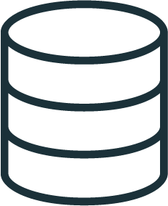



Building the foundation of a Lakehouse with ETL
BRONZE
SILVER
GOLD
Streaming Analytics
CSV,
JSON, TXT…
BI & Reporting
Data Lake
Raw Ingestion and History
Filtered, Cleaned, Augmented
Business-level Aggregates
Data Science & ML
QUALITY
Notes:
Now, as new data is brought into organizations, data engineering teams have the job to process the messy data into clean, fresh, reliable data to fit the use cases it’s intended for.
Often, this gets represented as a clean flow
TRANSITION: But, the reality is not so simple

Slide 37

But the reality is not so simple
Maintaining data quality and reliability at scale is complex and brittle
Streaming Analytics
CSV,
JSON, TXT…
BI & Reporting
Data Lake
Event Hub
Data Science & ML
Notes:
The exponential increase in data sources and types happening inside enterprises means that building and maintaining reliable data pipelines has become one of the more challenging parts of data engineering.
The fragility of it all creates a huge challenge for maintaining reliability
If pipelines fail, it has a huge downstream impact on all the systems and teams that rely on the data
This makes poor reliability extremely expensive
From the start, implementing high quality pipelines is slow and difficult.
They are built with complex code and limited reusability.
Next, it’s hard to trust the data quality
Bad data is often allowed to flow through a pipeline undetected, devaluing the entire data set.
To maintain quality and ensure reliable insights, data engineers are required to write boilerplate code to implement quality checks and validation at every step of the pipeline.
Finally, as pipelines grow in scale and complexity, companies face increased operational load managing them which makes data reliability incredibly difficult to maintain.
Data processing infrastructure has to be set up, scaled, restarted, patched, and updated - which translates to increased time and cost.

Slide 38
Large scale ETL is complex and brittle
Complex pipeline development
Hard to build and maintain table dependencies
Difficult to switch between batch and stream processing
Poor data quality
Difficult to monitor & enforce data quality
Impossible to trace data lineage
Difficult pipeline operations
Poor observability at granular, data level
Error handling and recovery is laborious
Streaming Analytics
CSV,
JSON, TXT…
BI & Reporting
Data Lake
Data Science & ML
Notes:
Complex pipeline development
Hard to build and maintain end-to-end ETL dependencies
Difficult to switch between batch and streaming processing
Poor data quality & reliability
Difficult to monitor & enforce data quality
Impossible to trace data lineage
Difficult pipeline operations
Poor observability at granular, data level
Error handling and recovery is laborious

Slide 39

Section 2: Workflow - Jobs and Delta Live Tables
Key takeaway: Jobs can be single task / multi task DAG, each task can be one of the 6 allowed type, full API support
Each Task can be:
Single Task Job
t1
Notebook
JAR
Spark Submit
Databricks Jobs
Python
Delta Live Tables Pipeline
t1
t2
Python wheel
Multi-Task Job DAG
t3
API / UI support
Read: Workflows - Azure Databricks | Microsoft Docs

Slide 40
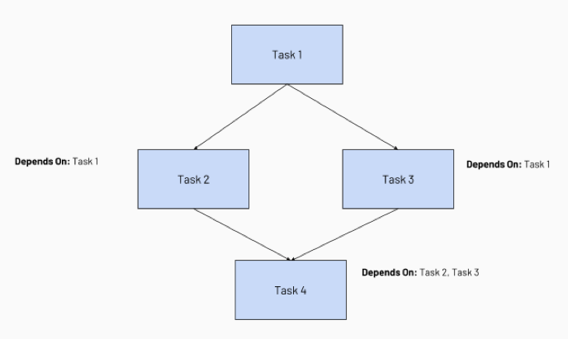
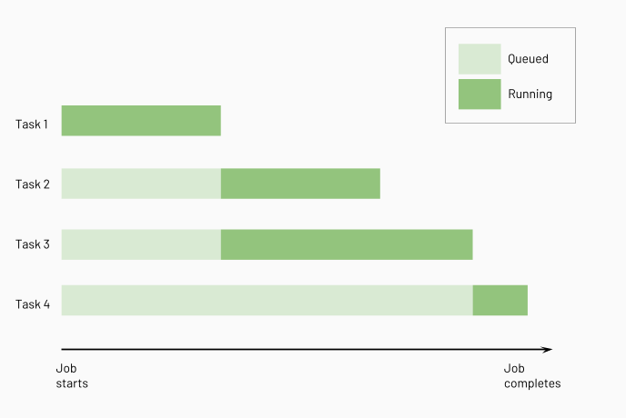
Section 2: Workflow - Multi-Task Jobs
Key takeaway: Jobs can be single task / multi task DAG, each task can be one of the 6 allowed type, full API support
Build DAG using Multi Task Job, Dependencies, Serial / Parallel
Job clusters can be reused across Tasks
Job clusters will run as many of them in parallel as possible (-> concurrency within single cluster - Scheduling within Spark Application)

Slide 41
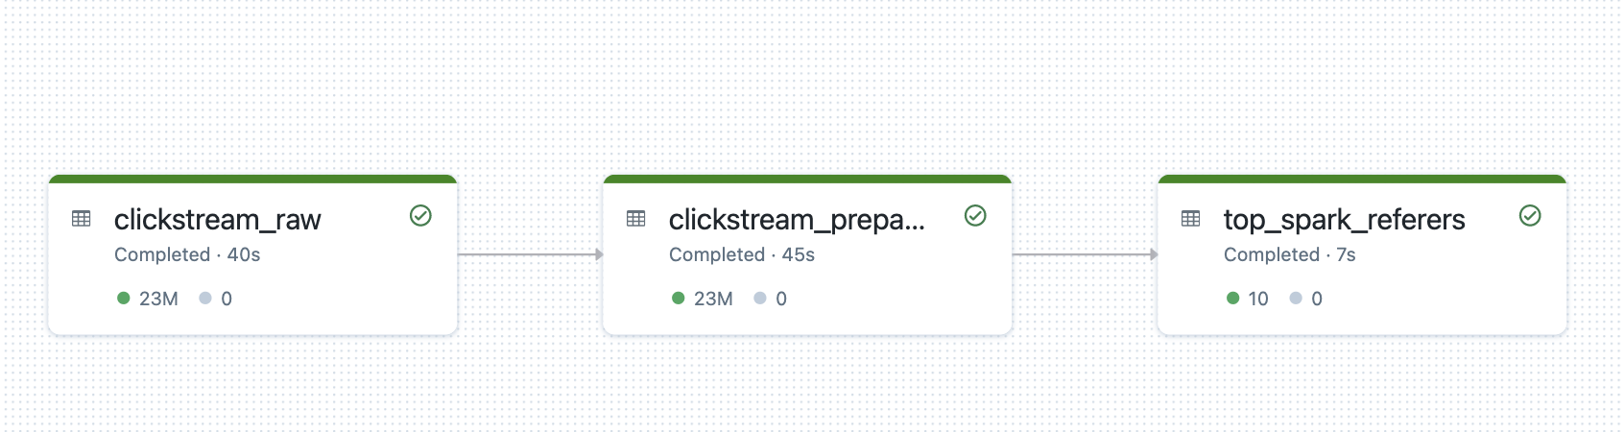
Section 2: Workflow - Delta Live Tables
Key takeaway: What is DLT?
Delta Live Tables
DLT is a Framework to Declaratively define your ETL pipeline
Table dependencies and execution sequence are
automatically figured out by Databricks
Key tasks are handled automatically (with option to customize)
handled for your pipeline, see boxes on the right.
Notebook
JAR
Spark Submit
Task orchestration
Python
cluster management
Delta Live Tables Pipeline
monitoring
Python wheel
data quality
error handling
Read: Delta Live Tables - Azure Databricks | Microsoft Docs

Slide 42



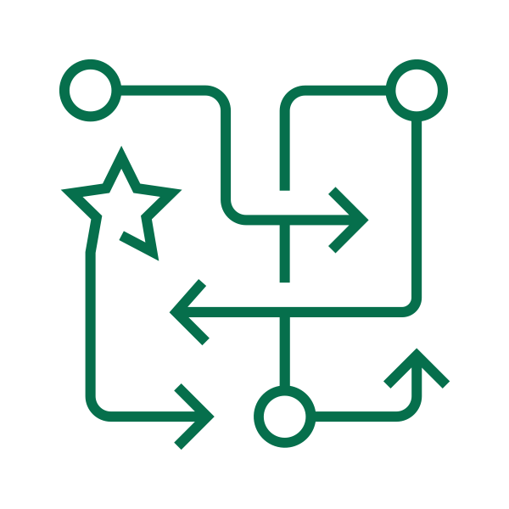


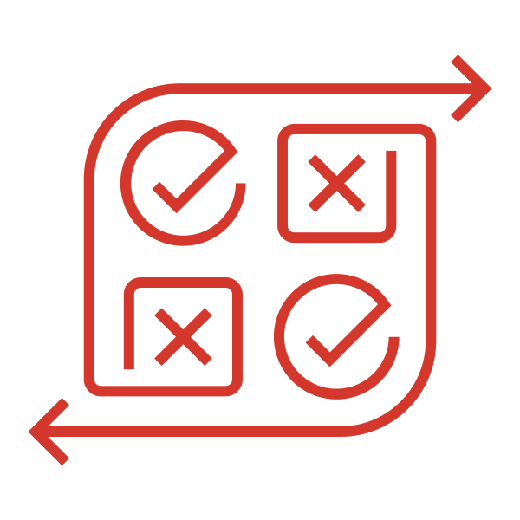

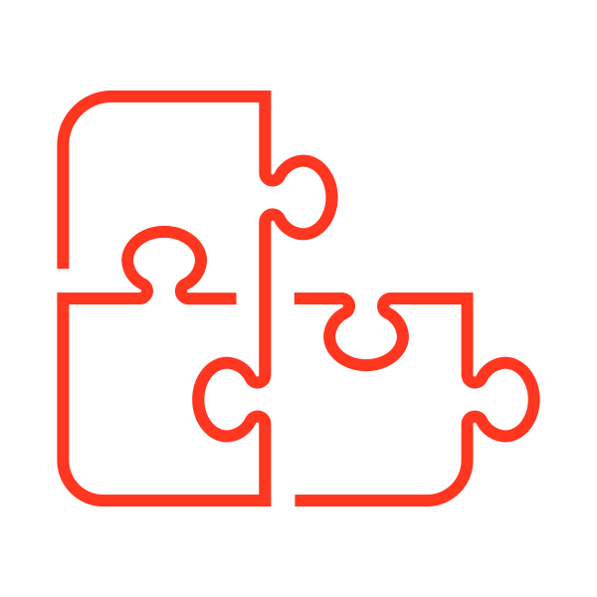





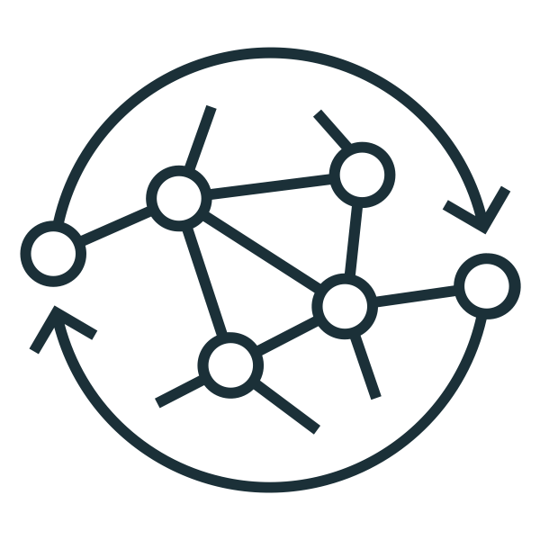



Section 2: Workflow - Build Production ETL Pipelines with DLT
Key takeaway: Where is DLT used at?
Databricks Lakehouse Platform
Business Insights
Continuous Batch or Stream Processing
Error Handling and Automatic Recovery
Data Pipeline Observailability
Automatic Deployments & Operations
Orchestrate Data Pipelines
Data Transformation
Analytics
Data Quality
Continuous or Scheduled Ingest
Bronze
Zone
Silver
Zone
Gold
Zone
Data Quality
Business Level Aggregates
Machine Learning
Photon
UNITY CATALOG
Operational Apps

Slide 43
Section 2: Best Practices on ETL
Key takeaway: Declarative SQL & Python APIs for DLT
Source
/* Create a temp view on the accounts table */
CREATE STREAMING LIVE VIEW account_raw AS
SELECT * FROM cloud_files(“/data”, “csv”);
Declaratively build data pipelines with business logic and chain table dependencies
Run in batch or streaming with structured or unstructured data
Reuse ETL pipelines across environments
Automatically generate lineage based on table dependencies across the data pipeline
Automatically checks for errors, missing dependencies and syntax errors
Bronze
/* Stage 1: Bronze Table drop invalid rows */
CREATE STREAMING LIVE TABLE account_bronze AS
COMMENT "Bronze table with valid account ids"
SELECT * FROM fire_account_raw ...
Silver
/* Stage 2:Send rows to Silver, run validation rules */
CREATE STREAMING LIVE TABLE account_silver AS
COMMENT "Silver Accounts table with validation checks"
SELECT * FROM fire_account_bronze ...
Gold
Read: Delta Live Tables - Azure Databricks | Microsoft Docs

Slide 44
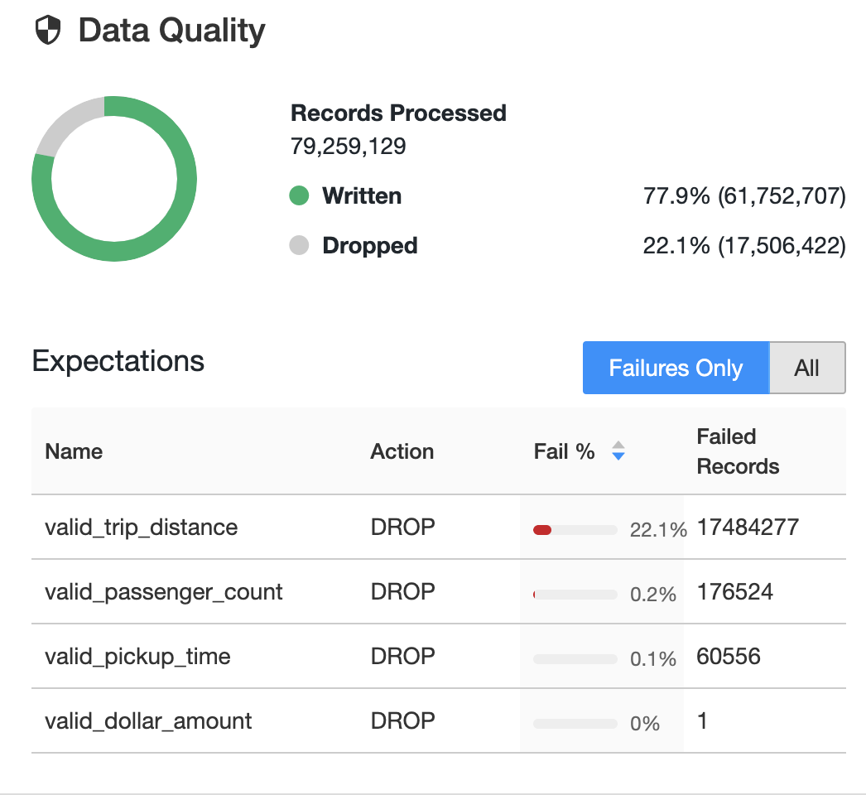
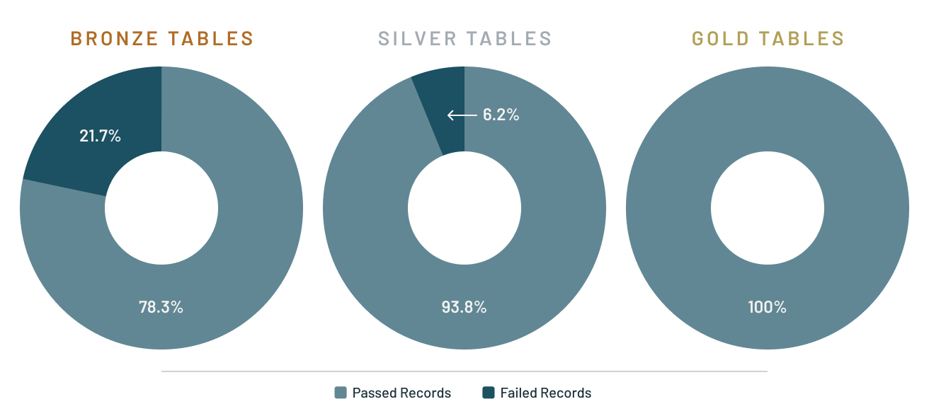
Section 2: Workflow - Delta Live Tables
Key takeaway: DLT benefit -> data quality, lineage, auto tracked and processed
Define data quality and integrity controls within the pipeline with data expectations
Address data quality errors with flexible policies: fail, drop, alert, quarantine(future)
All data pipeline runs and quality metrics are captured, tracked and reported
/* Stage 1: Bronze Table drop invalid rows */
CREATE STREAMING LIVE TABLE fire_account_bronze AS
( CONSTRAINT valid_account_open_dt EXPECT (acconut_dt is not null and (account_close_dt > account_open_dt)) ON VIOLATION DROP ROW
COMMENT "Bronze table with valid account ids"
SELECT * FROM fire_account_raw ...

Slide 45
Section 2: ETL - when to use DLT vs Jobs/MTJ
Key takeaway: When to use DLT, or not
Rule | Use DLT when…. | But not if… (for now)
Requirement | Streaming Ingesting from Auto Loader Need SQL API Better Auto Scaling for streaming workloads Data quality expectations Pipeline observability Lineage & documentation Automatic error handling and retry | You need Scala Have custom forEachBatch implementations that do more than just upsert/merge

Slide 46
Demo in Azure 10 min
Section 2: Best Practices on ETL
Key takeaway:
Use job clusters for automated jobs, $0.55/DBU (all-purpose cluster) vs $0.3/DBU (job cluster)
Choose your development in DLT / normal jobs, based on previous slide
Reuse job cluster across tasks in your job
Use instance pools to further reduce job cluster spin up time
Use photon-enabled clusters, especially on long ETL jobs
Streaming tasks should not have concurrent runs larger than 1
Streaming task should always be the final task in job, since it runs continuously
Use Delta Cache enabled VM instances (E/L series)
Read: https://docs.microsoft.com/en-us/azure/databricks/data-engineering/jobs/jobs

Slide 47
Splunk integration use cases open discussion (10 min)
Notes:
Tag:azure,aws,gcp

Slide 48

1 hour Lunch Break
13:15-14:15
Notes:
Tag:azure,aws,gcp

Slide 49
Workshop 2
14:00-16:00
Notes:
Tag:azure,aws,gcp

Slide 50
Day 1 Agenda - Workshop 2
14:00-16:00
Workshop 2 (2 hrs):
2.1 CICD with Databricks (60 min)
Azure DevOps example; basic branching strategy, jobs mgmt, deployment
2.2 Monitoring (60 min)
Databricks logs capabilities
Tools available for deep log analytics on Azure and Databricks
Overwatch - Deep Log Analytics
Use case discovery on logs
Remaining time will be used for live experiments in sc environment

Slide 51
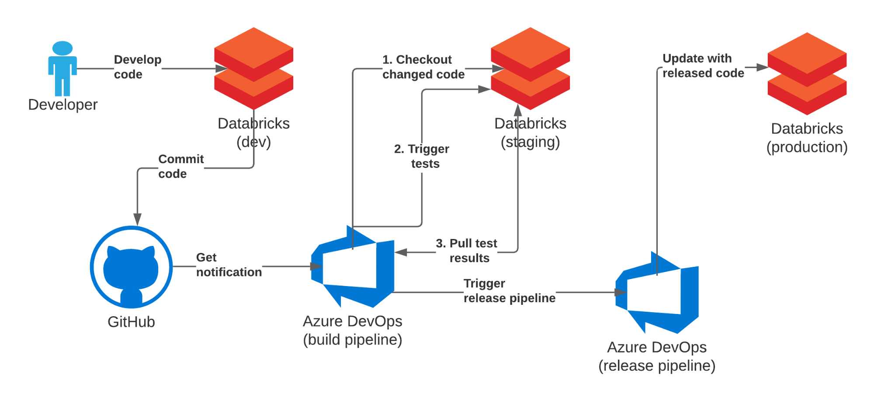
2.1 CICD and Azure DevOps (60 min)
Tutorial: https://github.com/alexott/databricks-nutter-repos-demo
Demo in Azure + Azure DevOps

Slide 52
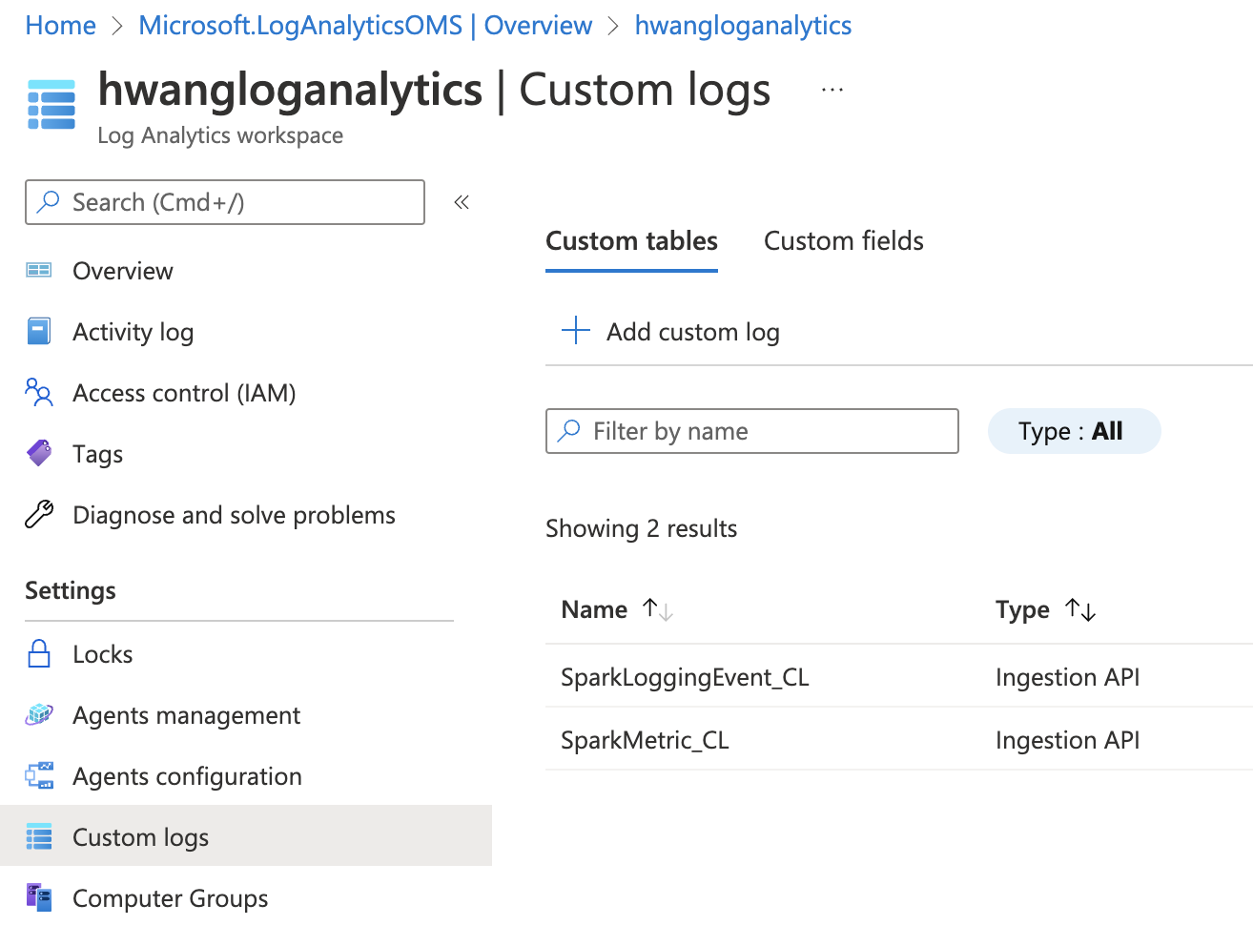
2.2 Logs from Azure Databricks
Demo in Azure Log Analytics
There are only 2 sources of platform logs on Azure Databricks:
Workspace diagnostic logs (Diagnostic logging in Azure Databricks) that include audit logs. Turn on verbose mode for more information on audit logs.
Spark clusters logs (Configure clusters - Azure Databricks | Microsoft Docs): These are the logs for the Spark driver node, worker nodes, and events. Logs are delivered every five minutes to your chosen destination. Including worker and cluster logs.
You will also encounter posts on Application logs and metrics: Send Databricks app logs to Azure Monitor - Azure Architecture Center | Microsoft Docs, these are the application logs, including log4j logs and cluster ganglia metrics (data source behind ganglia dashboard), using the spark-monitoring tool you can also add in custom logs into application logs. This is part of cluster log delivery logs.

Slide 53
Overwatch
Unifying Telemetry, Empowering the Customer
Daniel Tomes
2021-03-23

Slide 54
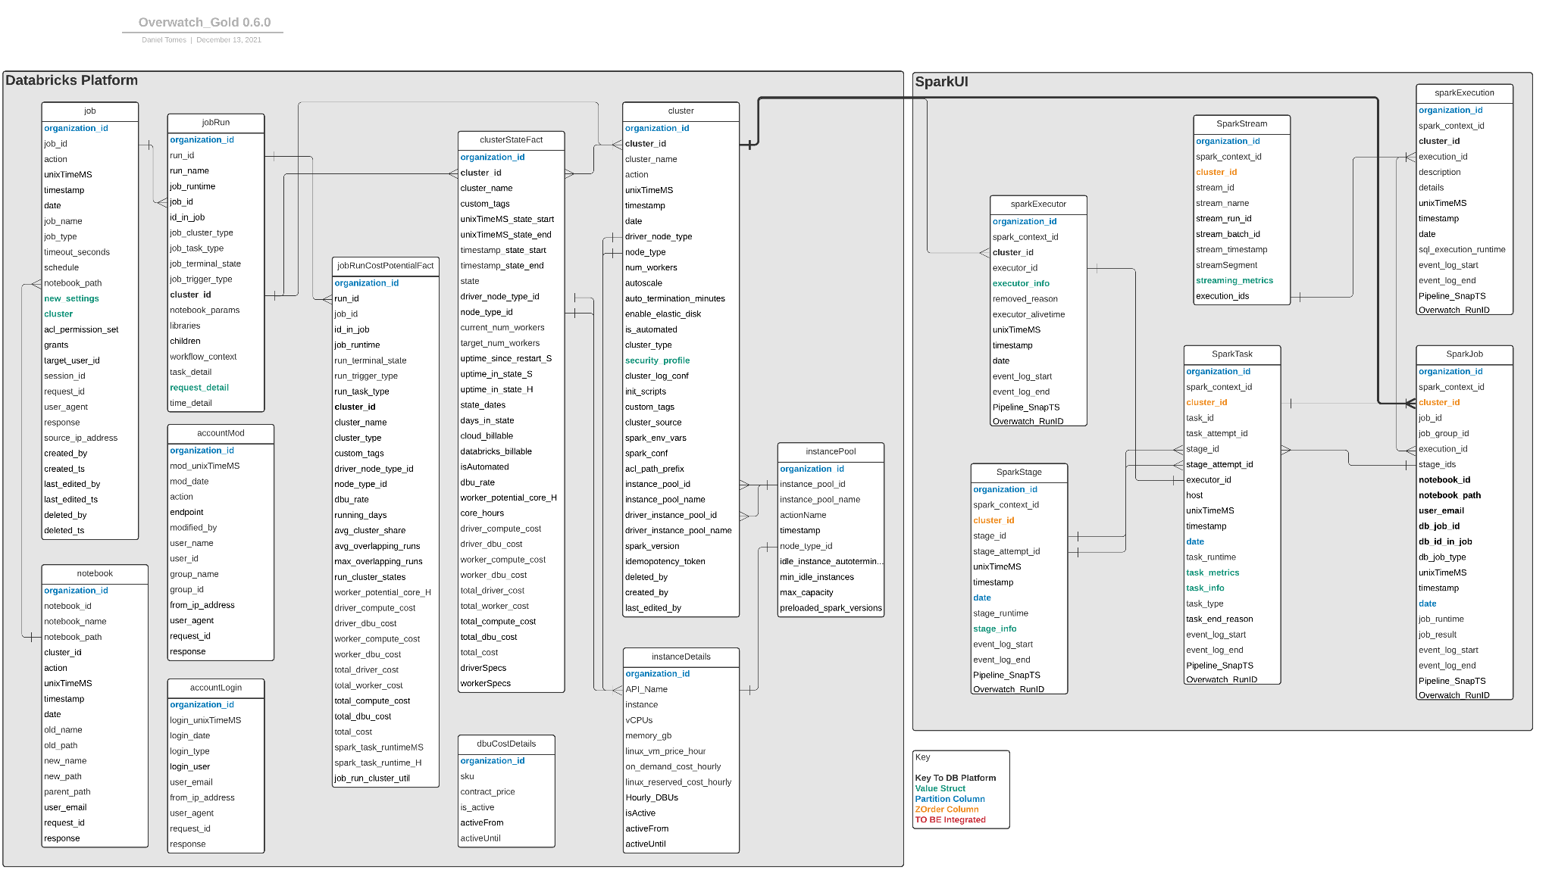
What Is It?
Tool - Enables Customer Observability
Compute / DBU Costs (estimated)
Dimensionalized Metrics:
Jobs
Clusters
Notebooks
Spark
etc

Slide 55
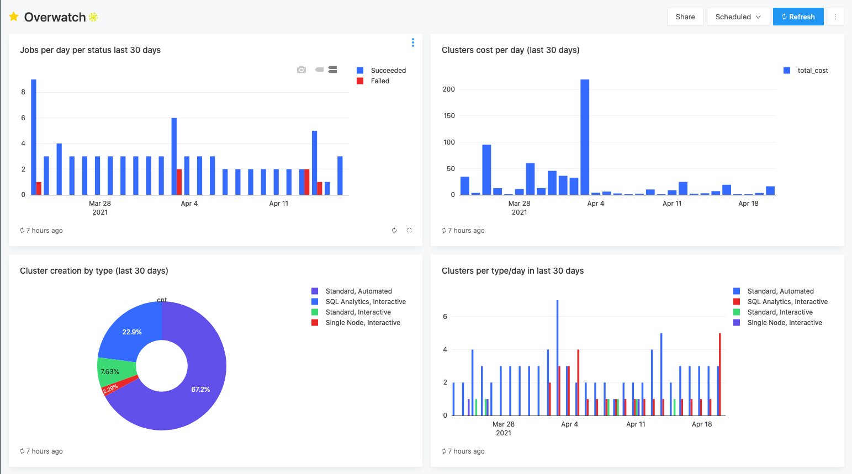
What Is It?

Slide 56
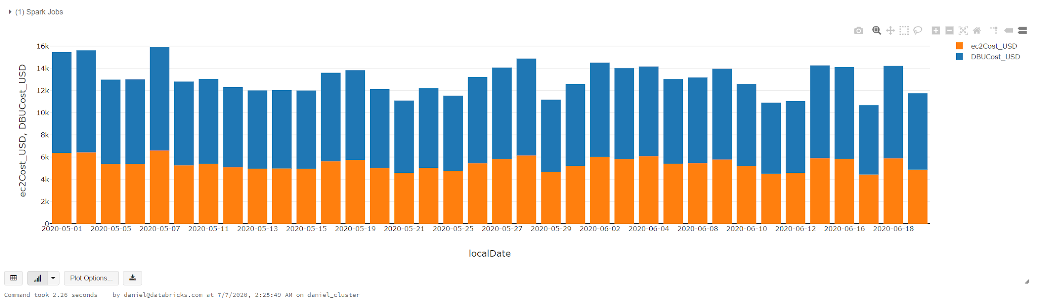
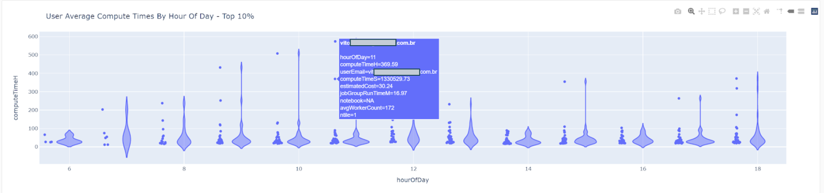
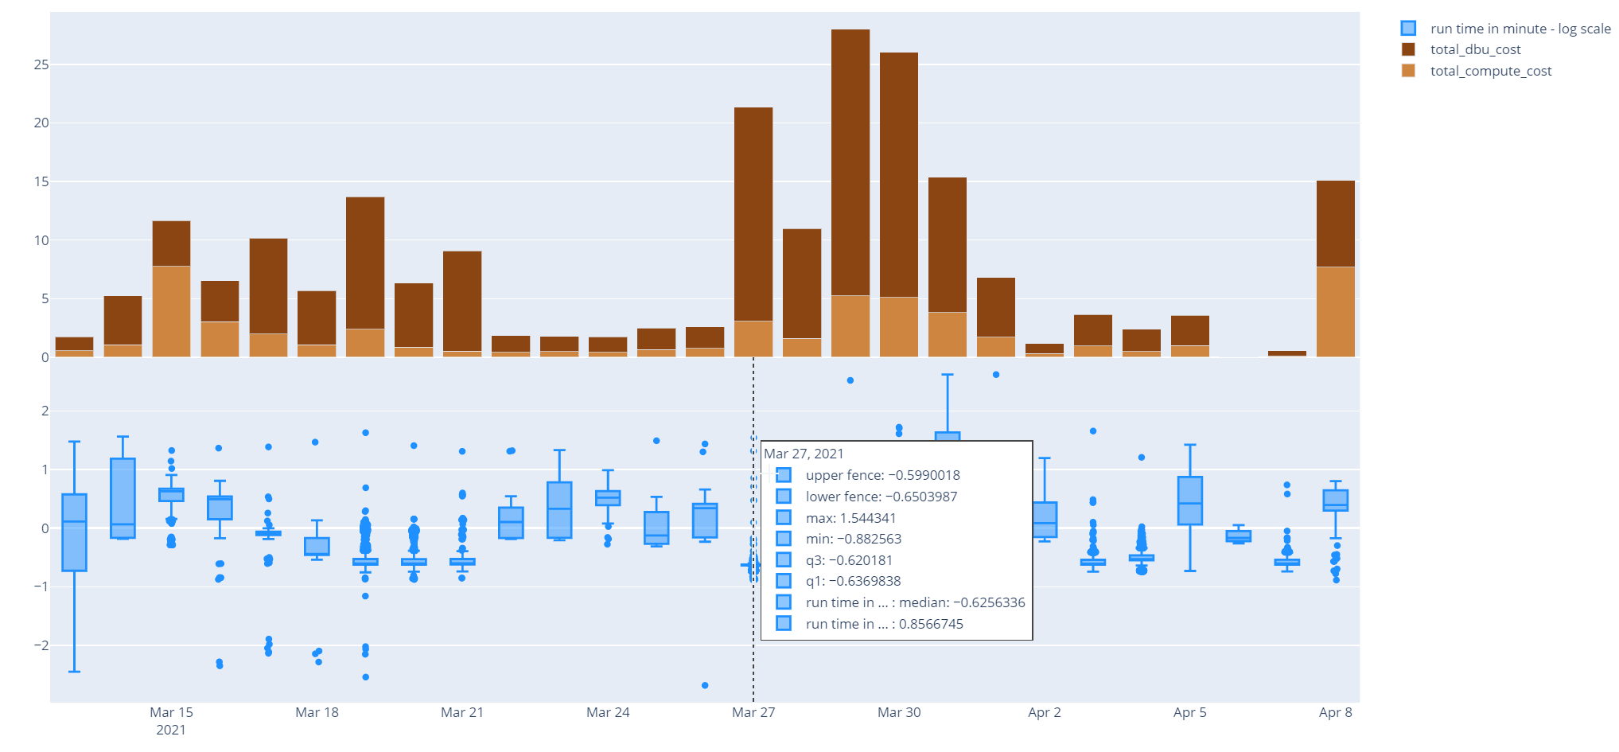
What Is It?

Slide 57
What Is It?
Capture:
Data Plane Only
Configurable Job that runs in customer environment[s] and unifies platform data with Spark data providing customer with holistic, detailed view of their environment.
Output is a database / data model with platform + spark dimensions and measures
Consume:
Interrogate the data to answer challenging questions that
drive down waste
identify bad habits
allow customers to make data driven decisions

Slide 58
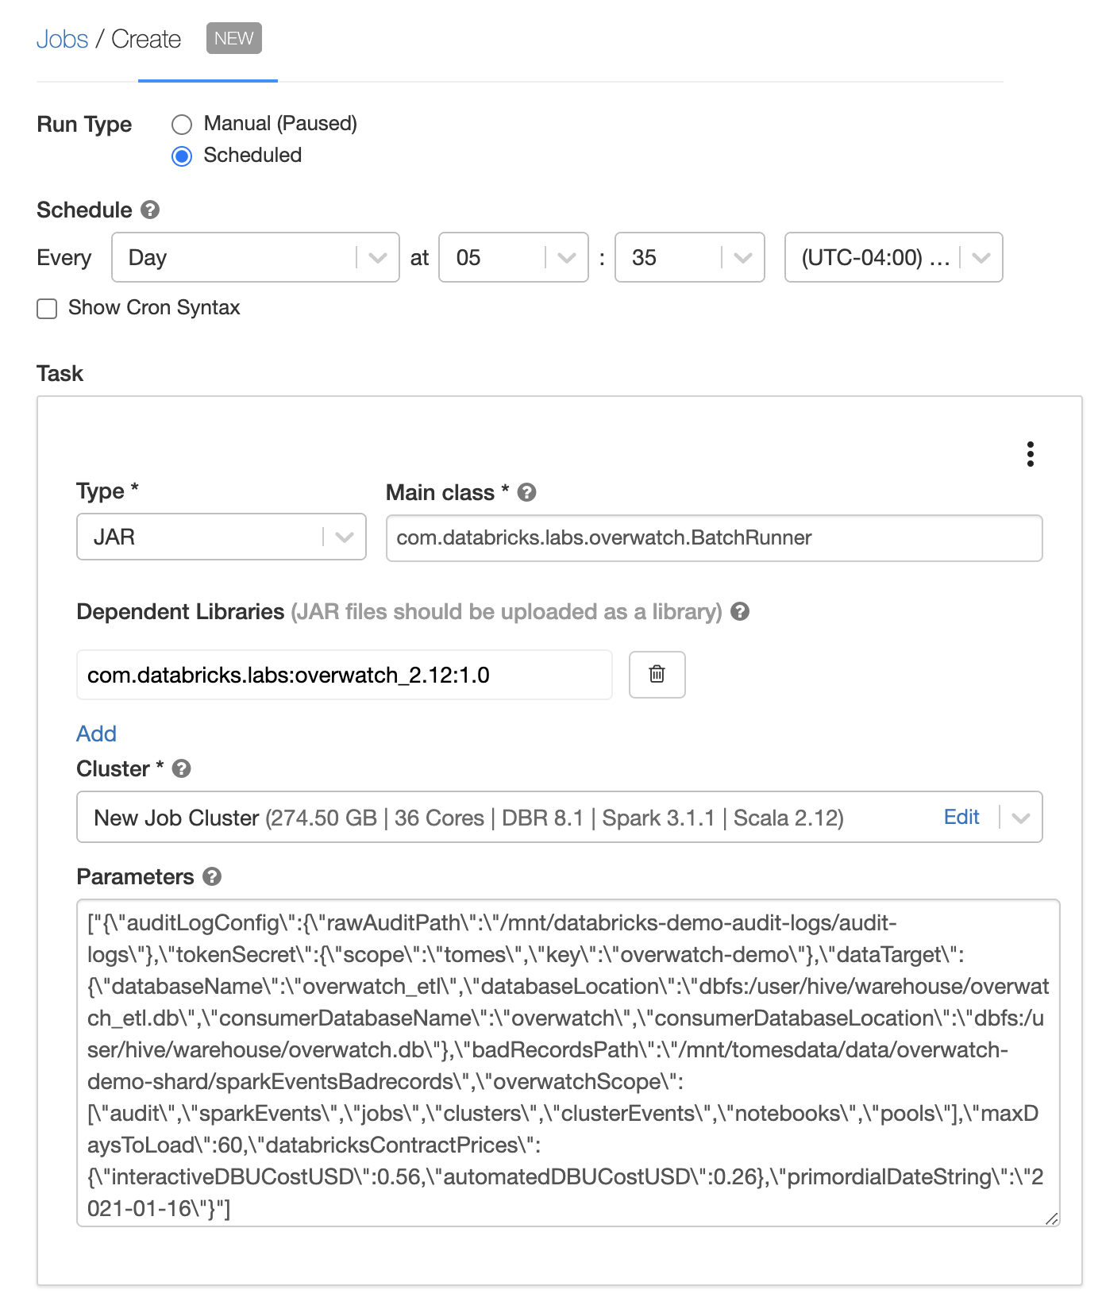
What Is It?
Capture:
Data Plane Only
Configurable Job that runs in customer environment[s] and unifies platform data with Spark data providing customer with holistic, detailed view of their environment.
Output is a database / data model with platform / spark dimensions and measures

Slide 59
What Is It?
Consume:
Interrogate the data to answer challenging questions that drive down waste, identify bad habits, and allow customers to make data driven decisions.

Slide 60
Primary Goal
Customer Enablement
Global Usage Tracking
Across workspaces, clouds, regions, teams, etc
Identify patterns/outliers and take targeted corrective actions
Measuring Value
Quantify ROI
Justify spend and/or refocus
Maximize $DBUs -- Minimize Discounts -- Lower TCO
Empowering Governance
Monitoring
Strategic, targeted behavior modifications
COEs can quantify their value and grow their teams

Slide 61
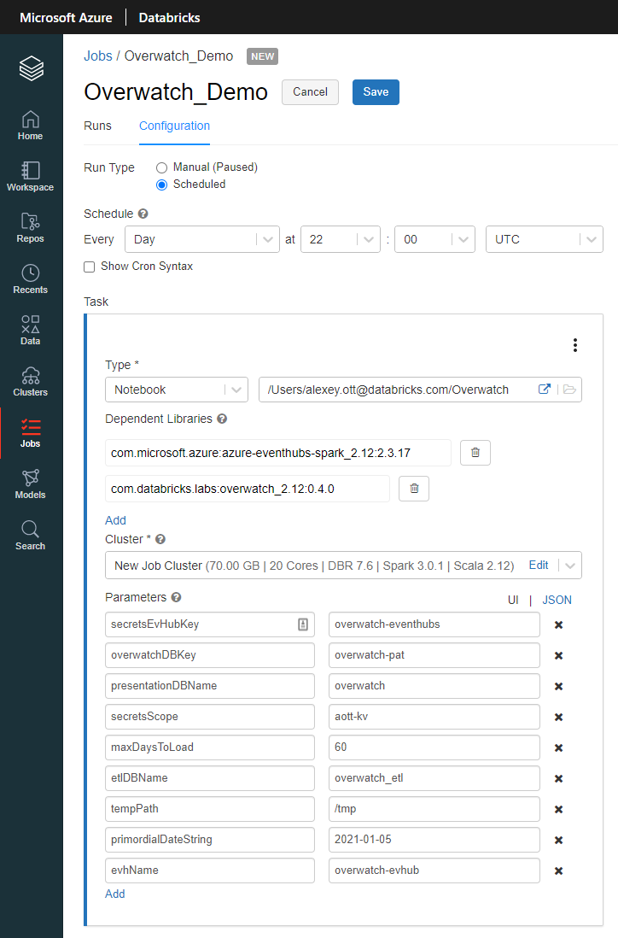
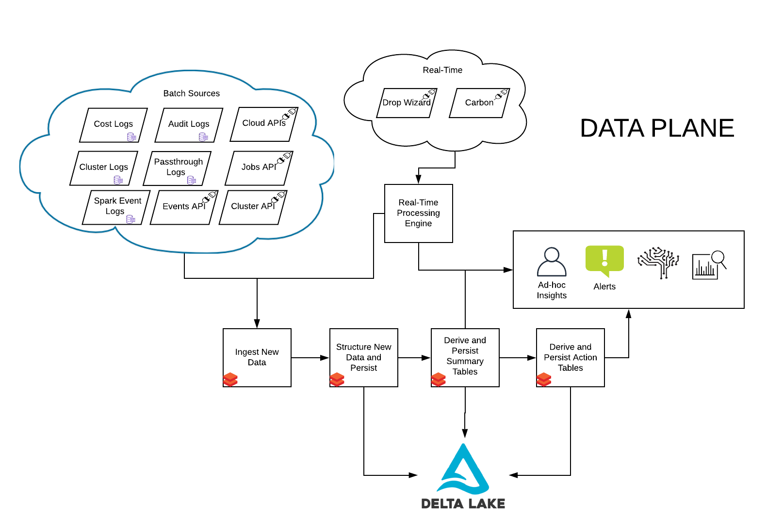
Methodology

Slide 62
Result - Dimensionalized Data Model
Combining Spark UI with Platform Metadata is extremely powerful

Slide 63
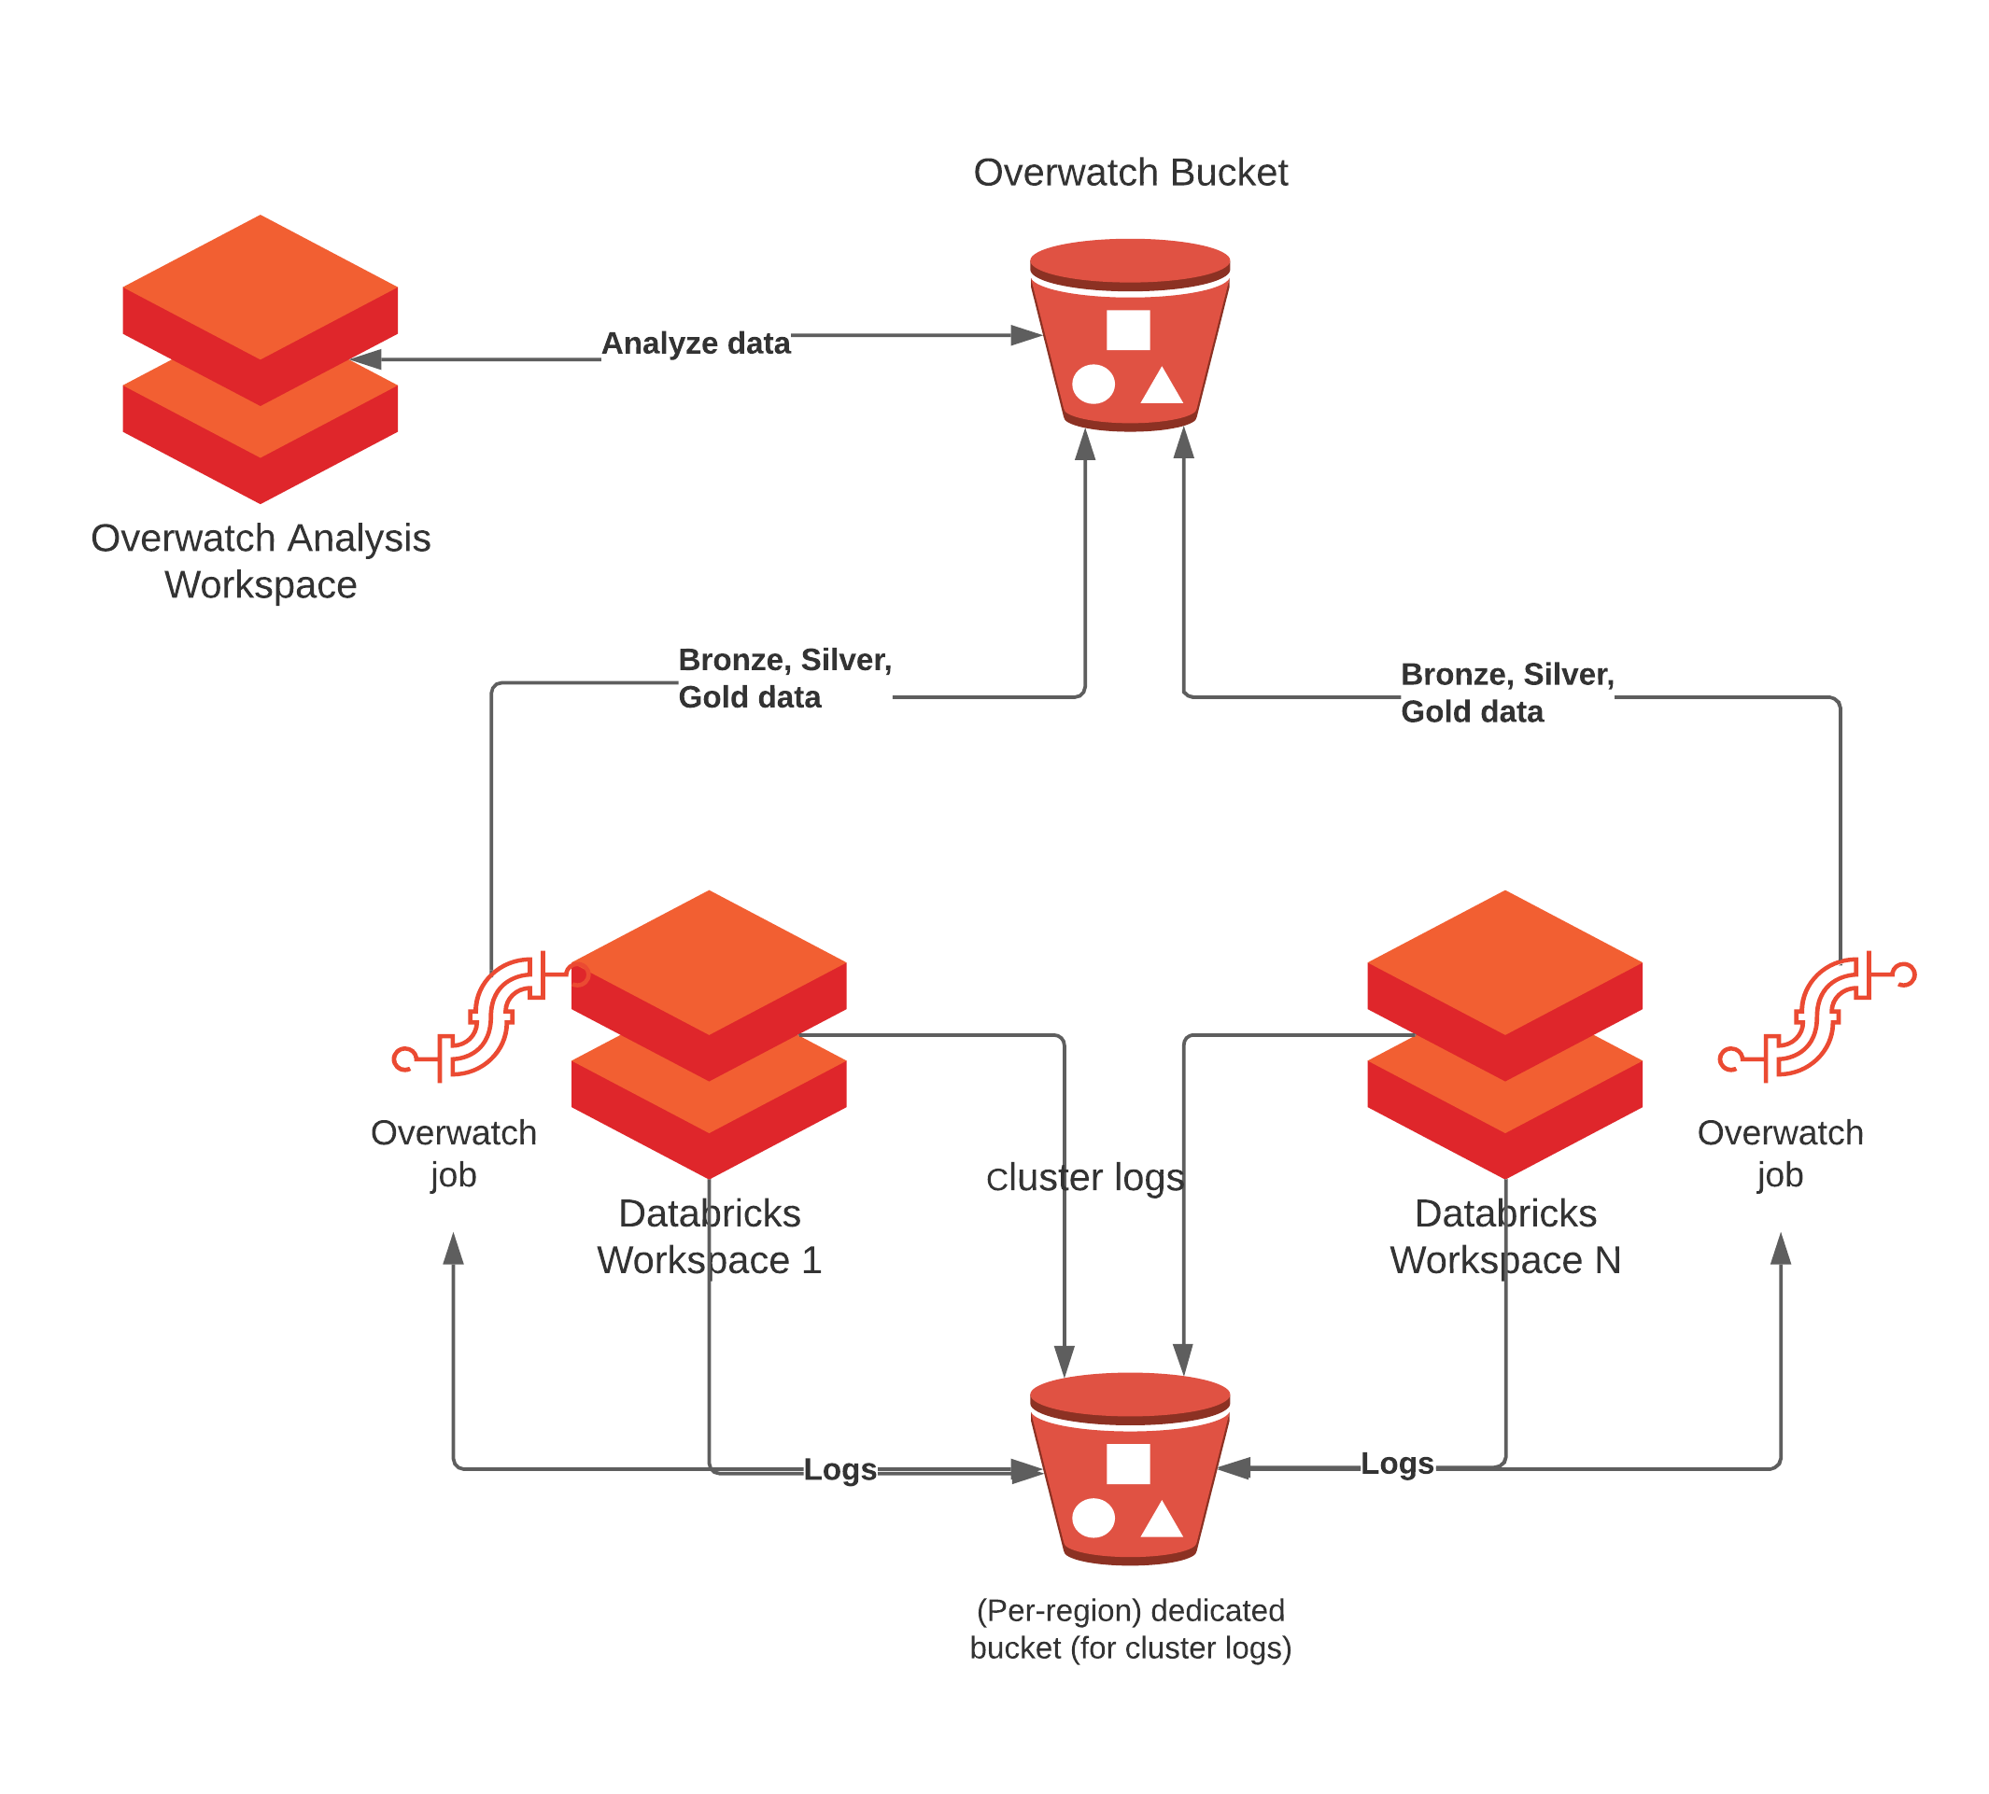
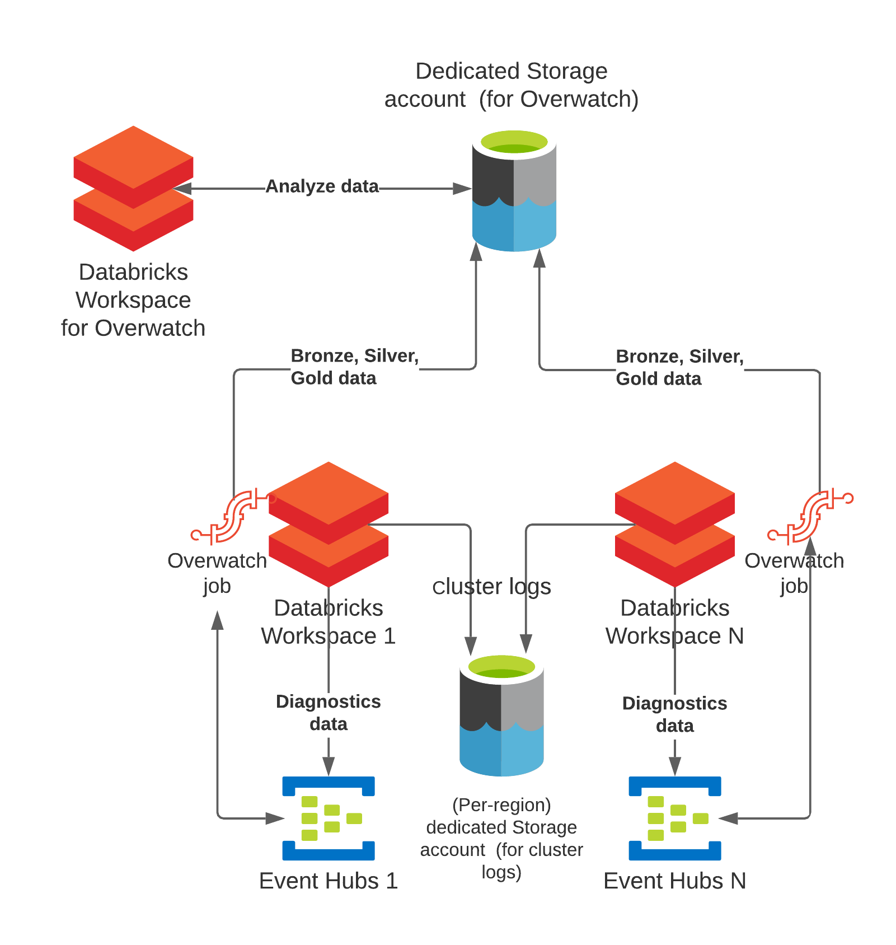
Many Workspaces? Multi-Cloud?
No Problem
Single Overwatch Instance / Workspace
Analyze from 1 or more workspaces

Slide 64
Features
Spark metrics combined with and dimensionalized by the Databricks platform metadata
Approximate costs by workspace, cluster, notebook, tag, jobs, time, user
Spot price optimization and compute cost tracking
Runtimes / standard deviations by job
Governance and monitoring
Historical configurations
Users / Groups / Logins
Utilization Metrics & Efficiency Stats
Outlier Identification
Simulations
Anti-pattern identification
And more...

Slide 65
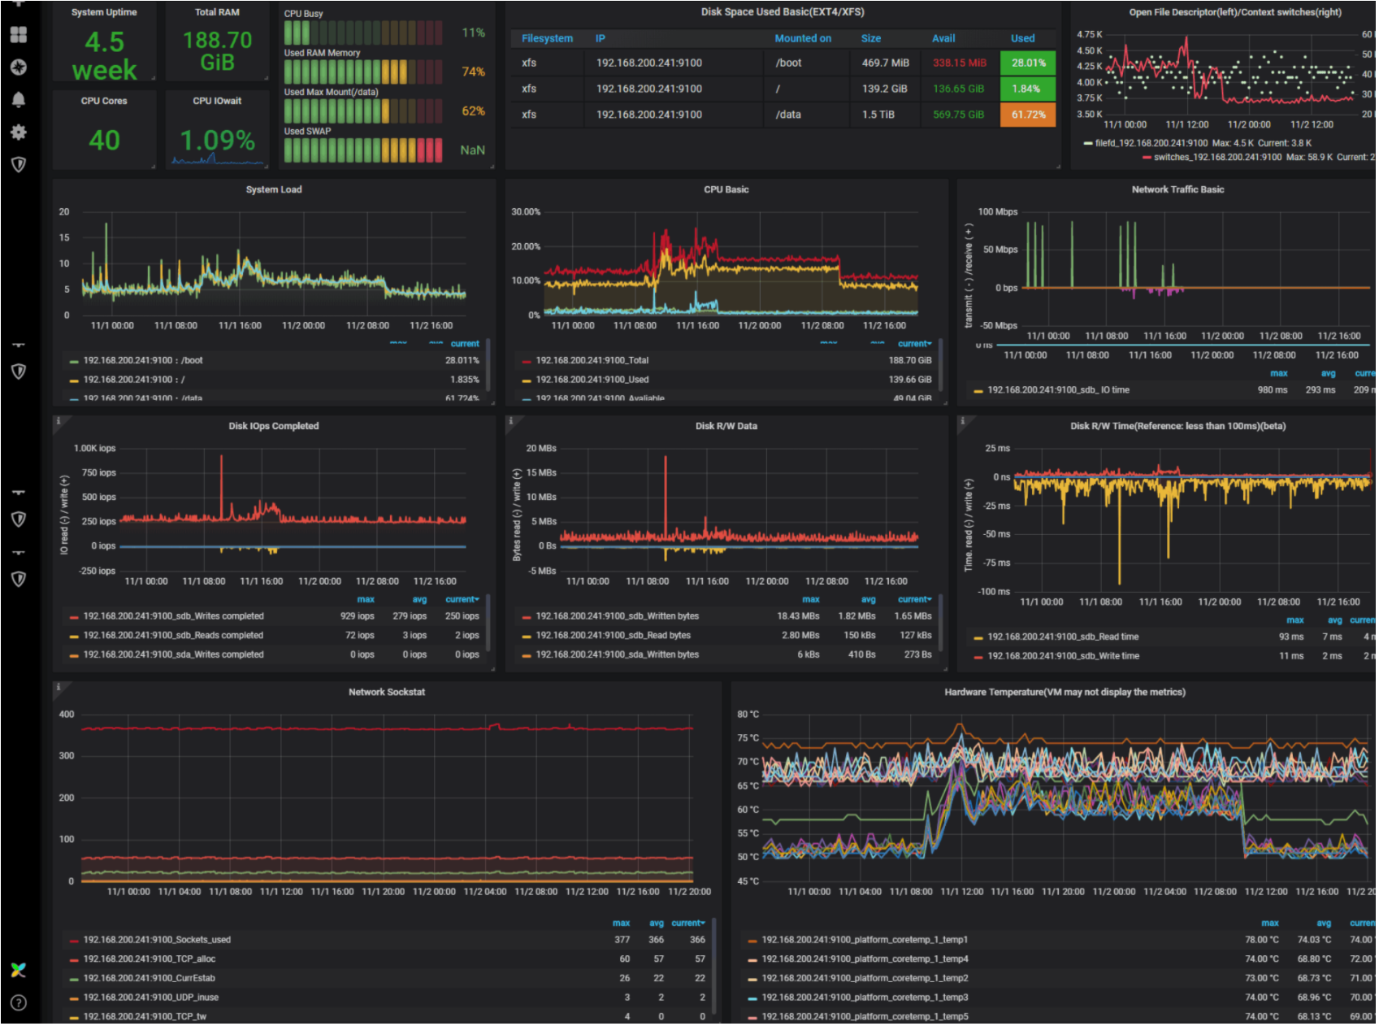
Real Time Monitoring / Alerting
Near-Real-Time Monitoring
Hardware + Spark
5s Resolution with staged rollups
Alerting
ML-powered predictions of failures
Note: Databricks provides the integration to customer’s compatible real-time platform:
JMX
Graphite
Prometheus
Log Analytics

Slide 66
Roadmap
Gold Model Build Out
DBSQL
Unity Catalog
Delta Sharing
JDBC
Multi-Workspace Deployment from single workspace

Slide 67
Sample Use Cases
The following slides provide example dashboards that have been anonymized. These are meant to support deeper discussions as necessary

Slide 68
Use Case Examples
Estimated Costs through time across all workspaces in a single place
Includes Compute with Estimated Spot Price (Spot Price History API)
EC2 + DBU Costs By Day

Slide 69
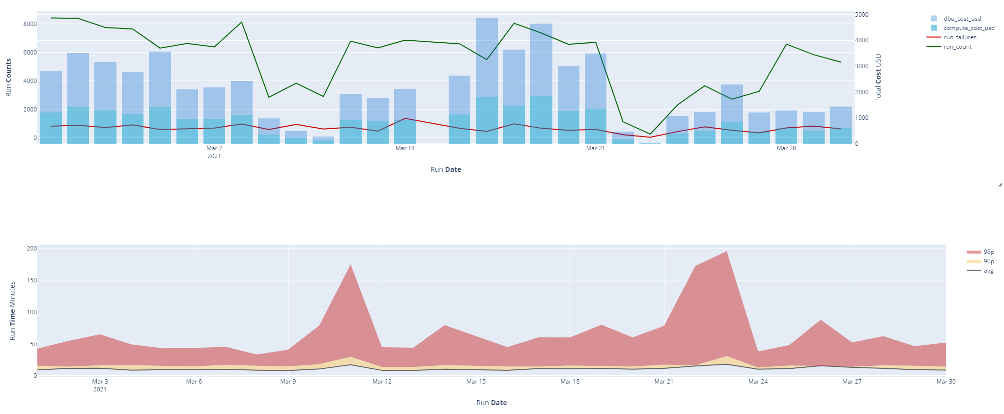
Value Add
Jobs Health & Status

Slide 70
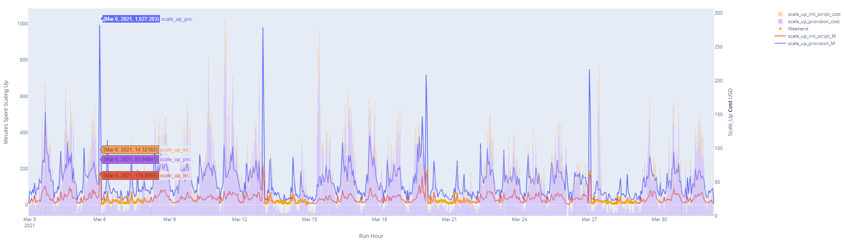
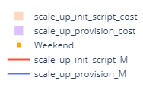
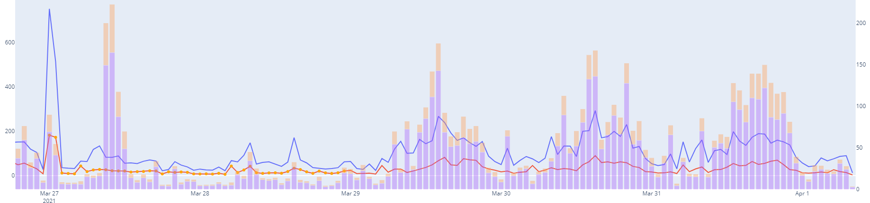
Cluster Scaling Efficiency
Monitor high-level dashboard like this for patterns and anomalies
This chart is global by hour but a simple filter can make it relevant for a specific team, application, landscape, workspace, etc.
Bars show the cost of scaling clusters up.
Lines show the time (minutes) spent scaling up clusters each hour
Higher Scale Up Times
Higher Scale Up Costs

Slide 71
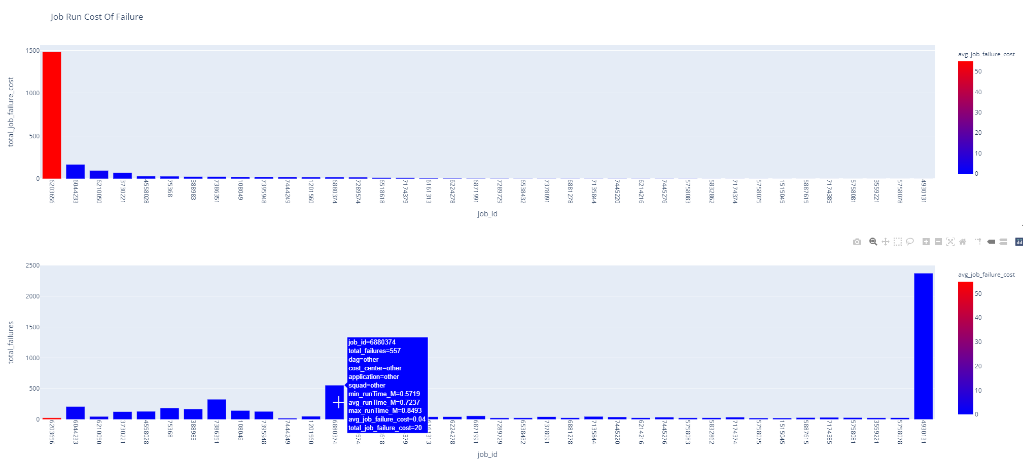
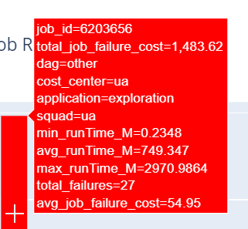
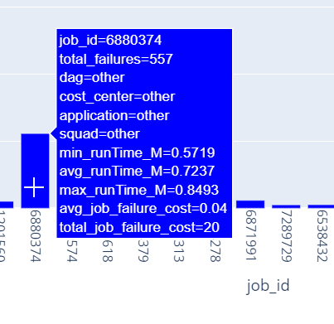
The Cost Of Failure
Blue - Inexpensive; Red - Expensive
(measured by avg cost of job failure)
Height of Bar - total USD loss from job failures last 30d
Every time this job fails it costs $55 on average
It’s failed 27 times in last 30 days
Large variance in runtimes
Decision = INVESTIGATE immediately
Height of Bar - total failure count last 30d
Only costs $0.04 / failure...but…
It’s failed 557 times in last 30d.
Decision = Investigate as time permits

Slide 72
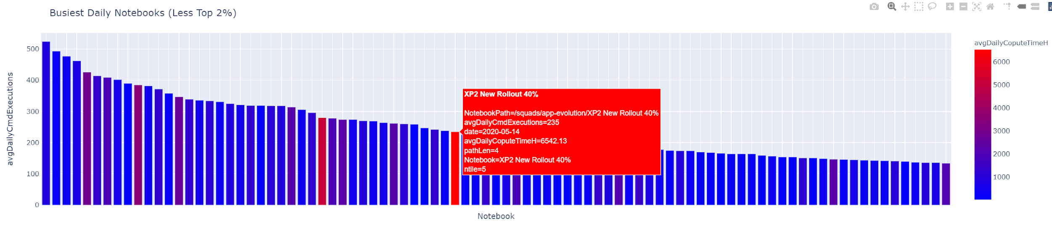
Costly Notebooks By Command Executions Over Costs
6,542 core hours on this one notebook per day?! Across 235 commands?
Is it efficient? Should we be doing this work in a notebook?
Oh, there’s the notebook path and it also tells me the squad that owns it. Let me ask for access and review it.
What’s Missing?
Number of distinct users running these executions? Top user email?
These answers would help me determine how popular the notebook is and the power user to get in touch with to explain it to me.
Simply join to user table and add those dimensions. Omitted here for privacy
Blue - Inexpensive; Red - Expensive
(measured in average core hours)
Height of Bar - average command executions / day across last 30d
just means minus max outliers, analyzed differently

Slide 73
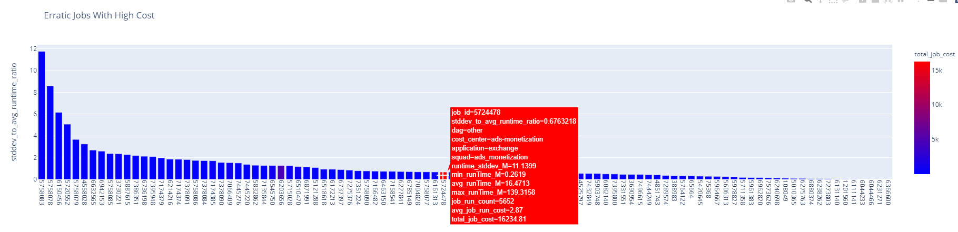
Use Case Examples
Most Erratic Jobs And Associated Costs
Erratic jobs with high costs are often a primary optimization opportunity
$16,234 over past 30 days across 5,652 runs
average runtime = 16.47 minutes but max runtime is 139.32 minutes, why?
Variable source data? Skew? Busy cluster? Spot availability? Node Type? Code issue? Antipattern? The answer is only a few queries away
Blue - Inexpensive; Red - Expensive
Height of Bar - measure of a job’s run variance ( > 50% variance is fairly high )
Highly varying runtimes
but, inexpensive, not worth time to dig into now
Significant variance - 67%
extreme relative cost
Low Variance, Inexpensive

Slide 74
Use Case Examples
Expensive Users - Past 30d
Given top 10% of average query times during peak hours, which users are accounting for the largest spend?
These are my top, top most expensive users. Is their work capturing the necessary ROI? Are they efficient? What kind of trainings may help?
Vito is spending an average of $30 per workday in the 11 o’clock hour and running on an average of 172 nodes. What is he doing? Can I help him do it better? Anti-patterns? Data set size? Autoscaling?
Finding - crypto mining. JK, but could have been...
Each Blue Dot == A user at a corresponding hour of the day
Red line == Well, the red line - Users (dots) above this line warrant investigation
Actionable Intel

Slide 75
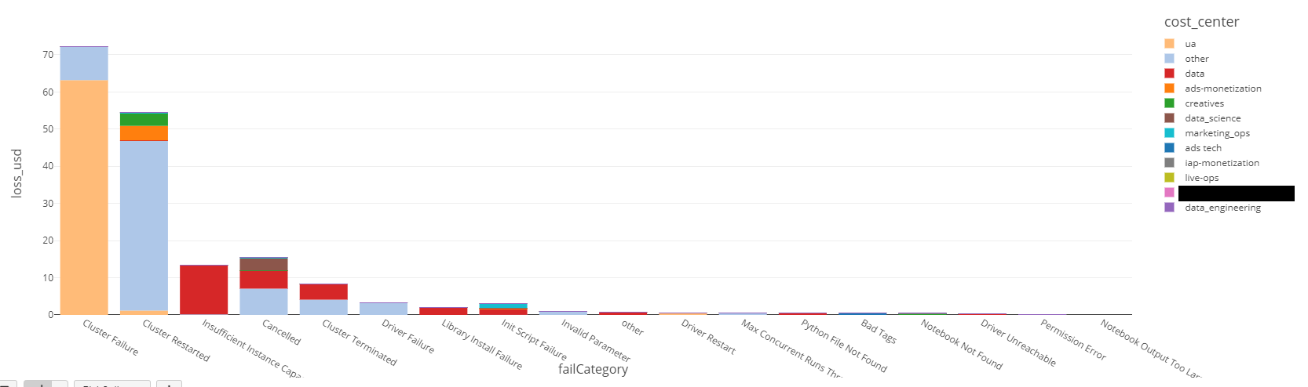
Use Case Examples
Most common job run failure reasons, Rolling 30d
Which clusters / jobs have had the most issues over past 30d and what was the summarized categorical cause
Luckily the loss from errors isn’t too high but it’s clear that the ua cost center has many cluster failures
Loss in USD by job failure category by cost center (Rolling 30d)
The data team needs to use different node types or a different AZ as it’s clear a lot of their jobs are failing due to insufficient instances. Review spot pricing for node type across AZs could lower cost too.
A nice drill down would be into the data type by failCategory by day to see how many failures they’re getting per day and see if they just had one spike that caused a lot of this or if it’s a systemic problem.

Slide 76
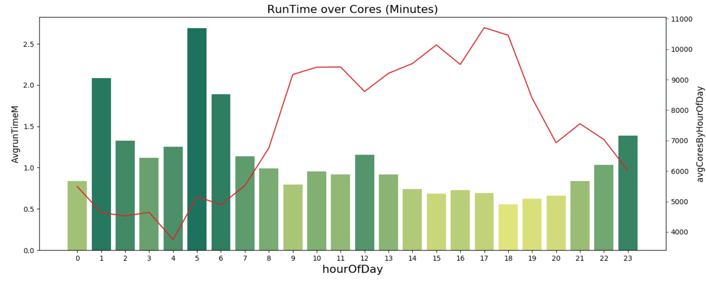
Use Case Examples
Customer wants to maintain a high user experience.
Goal, average notebook execution time of queries > 10s should be <= 60s
We are within the goal between hours of 8AM and 10PM and it requires approximately 10,500 cores to achieve this at peak.
CASE STUDY, Customer X
Demonstrates good use of autoscaling
Monitor for Deviations / slip
What’s missing? Well, a deeper dive was conducted to determine largest clusters and their utilization. This was combine with execution counts by cluster by hour of day to fine-tune the 32 clusters that made up this 10,500 cores. Later, query efficiency was analyze by user to break users apart by workload type and proficiency.
Ultimately, required avg peak cores reduced to 7,500

Slide 78
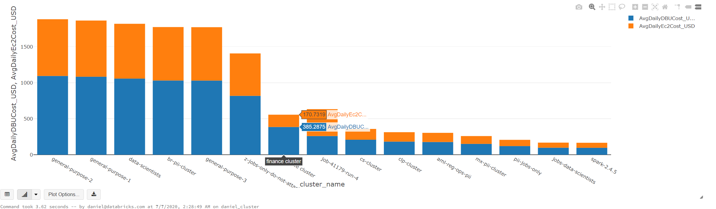
Use Case Examples
Most expensive clusters (daily avg) across workspaces rolling 30
DBU + Compute

Slide 79
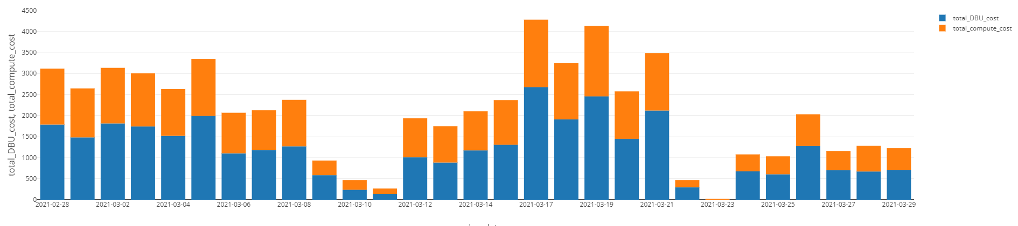
Use Case Examples
Rolling 30d Job Costs By Day
Heaving Streaming -- Smoothed across days, latest days not fully calculated until stream jobs stop

Slide 80
Q&A
Notes:
Tag:azure,aws,gcp

Slide 81
Day 1 Closing - Q&A, Live Deployment in SC
16:00-18:00
Q&A (2 hrs):
3.1 Any question from Workshop Topics
Splunk-integration
Basic ETL process and orchestration
Databricks Logs
Use case discovery
3.2 Live Deployment in your Azure env
Terraform questions
Discuss Architecture Diagram

Slide 82
Appendix 1:
In-depth explanation on Data Exfiltration Protection
AzureDatabricksBestPractices/toc.md at master
Notes:
Tag:azure,aws,gcp

Slide 83
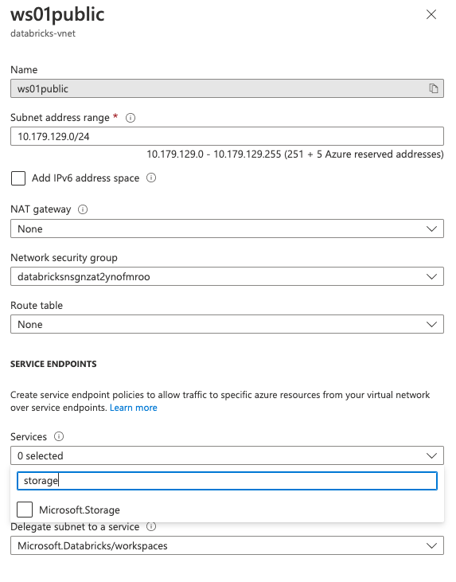

Section 2.1: Components - Service Endpoints
Key takeaway: SE lets you connect from subnets to PaaS’s public endpoint via Azure Backbone
Service Endpoint is like a “property” of subnet, not an actual resource.
With SE on, you use private address in your subnets to access Azure PaaS’s Public Endpoint, traffic remains in Azure Backbone and has an optimized route. Then to lock down the PaaS service so it only accepts traffic from the subnet associated with the service endpoint.
You can remove all public network ACL from storage account but storage account still has public endpoints (exposed to Internet).
No cost for service endpoints.
Service Endpoint is for Azure VNets (subnets level) only, no support for onprem traffic.
Service Endpoint
Private Endpoint
UDR
Firewall
Subnet setting

Slide 84

Section 2.2: Components - Private Endpoints
Key takeaway: Each PE consuming 1 private IP, connecting your VNet to PaaS private IP via Azure Backbone
Private Endpoint is an actual resource, to be deployed into your subnet and connects to PaaS.
PE charges for both ingress and egress traffic and time, roughly $0.01/GB*
DNS must be configured such that the public address resolves to the private IP of its private endpoint. If custom DNS is used, need to add some records manually for correct mapping.
PE must remain in the same region as the VNet it deployed into, but you can connect to PaaS in another regions.
Azure vnet routing automatically figures out if your in-vnet traffic should go through the PE to PaaS.
PE works for onprem scenarios.
Service Endpoint
Private Endpoint
UDR
Firewall
*See latest doc for pricing

Slide 85

Section 2.3: Components - UDR
Key takeaway: use UDR to route egress traffic from ADB subnets to private IP of firewall, UDR overwrites default routes
You can use User Defined Routes to control how your traffic flows within VNet at high granularity
Read all details here: Azure virtual network traffic routing | Microsoft Docs
Next hop just means where should Azure route this traffic to as next step (can see from effective routes)
Service endpoint routes override any BGP or UDR routes for the address prefix match of an Azure service.
Workflow: create route table -> add custom routes -> associate route table with subnets
In ADB exfiltration protection setup, we just need to route ADB subnets egress traffic (0.0.0.0/0) to firewall private IP, via a user defined route.
Service Endpoint
Private Endpoint
UDR
Firewall
System Routes | Auto created and associated with each subnet
Custom Routes | User defined Routes, can override some system routes
0.0.0.0/0 address prefix | A route with the 0.0.0.0/0 address prefix instructs Azure how to route traffic destined for an IP address that isn't within the address prefix of any other route in a subnet's route table.
Next hop type (read full list details on doc!) | Virtual appliance: A virtual appliance is a virtual machine that typically runs a network application, such as a firewall. None: Specify when you want to drop traffic to an address prefix, rather than forwarding the traffic to a destination. Internet: Specify when you want to explicitly route traffic destined to an address prefix to the Internet, or if you want traffic destined for Azure services with public IP addresses kept within the Azure backbone network.
VM in this subnet initiates traffic
1
VM traffic trying to reach address prefix
2
Then this traffic will be routed to next hop 10.178.0.4
3

Slide 86

Section 2.4: Components - Firewall
Key takeaway: we need to allowlist control plane services IP and FQDN, in hub firewall
Denies everything by default
Network rules (by IP address) and Application rules (by FQDN, domain names)
Each rule set has priority level, smaller number means higher priority.
Service Endpoint
Private Endpoint
UDR
Firewall
Processing logic sequence: DNAT rules -> Network rules -> Application rules, regardless of Rule collection priority and policy inheritance -> e.g. if you have a priority 200 application rule conflicting with priority 50000 network rule, Azure will still choose to follow the network rule at priority 50000.
The rules are terminating -> if a match is found in a network rule, no other rules are processed.
For ADB exfiltration protection setup, we need Firewall to allowlist control plane services IP range, and FQDNs.

Slide 87
Section 3.1: ADB UDR & Firewall & Private Link
See Benhard’s original deck for details: 2.2 Azure Databricks - System Architecture 2022-05-06
Firewall rules
 | Name | Purpose
1 | databricks-webapp | Communication with Azure Databricks webapp
2 | databricks-log-blob-storage | Store Azure Databricks audit and cluster logs (anonymized / masked) for support and troubleshooting
3 | databricks-artifact-blob-storage | Databricks Runtime images to be deployed on cluster nodes
4 | databricks-dbfs | Azure Databricks workspace root storage
5 | databricks-sql-metastore | Stores metadata for databases and child objects
... | ... | Business specific rules (artifactory, monitoring, …)
Customer on premises
Databricks Control Plane
(Microsoft VNet)
Web App
Browser
@
1
User
BI Tools
Metastore
SCC Relay
5
@
@
REST Client
3
@
Log / Tele- metry (TM)
Artefact Store
2
@
Notes:
All traffic is routed according to User Defined Routes (UDR)
It is not recommended to route the SCC connection through Azure Firewall (avoid the additional hop)
Optionally, one can set up an external Metastore, e.g. Azure SQL (also behind a Private Link)
This architecture can be combined with Private Link
Costs grows with Data volume filtered by firewall
Hub (Customer
Hub VNet)
4
Data Plane (Customer VNet)
@
host subnet
DBFS
Azure
Firewall
Databricks Clusters
PE subnet
Storage PE
UDR
VNet Peering
SCC
0.0.0.0/0
PE = Private Endpoint
= via Azure Backbone
= Public IP
ADLS
@

Slide 88


Section 3.1: ADB UDR & Firewall & Private Link
See Benhard’s original deck for details: 2.2 Azure Databricks - System Architecture 2022-05-06
Firewall rules
Find all these information (IP, FQDN) to fill the firewall rules from:
 | Name | Purpose
1 | databricks-webapp | Communication with Azure Databricks webapp
2 | databricks-log-blob-storage | Store Azure Databricks audit and cluster logs (anonymized / masked) for support and troubleshooting
3 | databricks-artifact-blob-storage | Databricks Runtime images to be deployed on cluster nodes
4 | databricks-dbfs | Azure Databricks workspace root storage
5 | databricks-sql-metastore | Stores metadata for databases and child objects
... | ... | Business specific rules (artifactory, monitoring, …)
User-defined route settings for Azure Databricks
For example: Control Plane services in Australia Central:
Automatically find these services IP and FQDN by having a periodic job -> this can be a parser (example: https://github.com/adb-essentials/adb-udr-automation
Also means downtime at IP change and reconfiguration of Firewall rules required! Connectivity and your workload may break at Control Plane services IP changes.
*From azure databricks UDR doc

Slide 89

Section 3.2: Notes on Service Endpoint Policy
Key takeaway: Service Endpoint Policy for exfiltration protection does not work with ADB
Customer may ask: Can I use Service Endpoint Policy for granular control on specific storage account connection? And it’s free.
-> Not possible for ADB to use SE policy for exfiltration protection (next page explains)
Subnets with SE can be attached with SE policy to control egress traffic to specific resources

Slide 90

Section 3.2: Notes on Service Endpoint Policy
Key takeaway: Service Endpoint Policy for exfiltration protection does not work with ADB
Why Service Endpoint Policy doesn’t work on Databricks subnets?
Read limitations: Azure virtual network service endpoint policies
For VNet injection setup, subnets are delegated to databricks, this associates immutable network intent policies. Service Endpoint Policy will easily contradict these network intent policies, thus not allowed to be attached.

